Slide 1
Fusion Live Assist ROI & Customer Benefit Analysis
May 2014

Slide 2
Executive Summary
CaféX Fusion Live Assist could drive business value to <client> by generating benefits that would reduce operational costs and lift revenue.
This report provides a sample business case for 1,000 concurrent sessions based upon a set of assumptions and benchmark data from CaféX clients of similar size to <client> that are utilizing CaféX Fusion.
Achieve a 12 month return on investment.
Realize benefits as much as $7 million over 3 years:
□ Lower agent costs by as much as $5.7 million over 3 years
□ Cut 800 inbound call charges by up to $500,000 over 3 years
□ Reduce travel costs by up to $450,000 over 3 years
□ Increase margin from higher revenues by up to $350,000 over 3 years
A detailed business case built on estimates specific to <client> can be constructed as a next step.

Slide 3
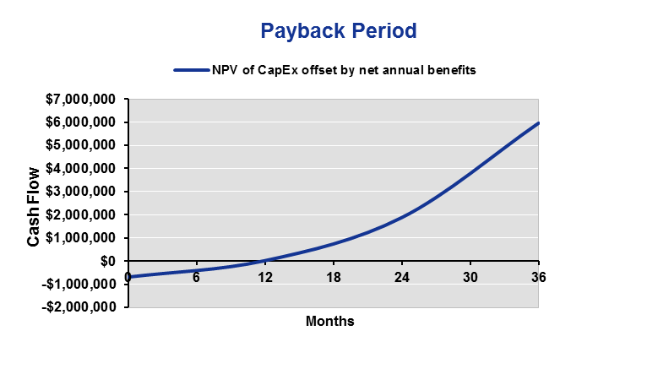
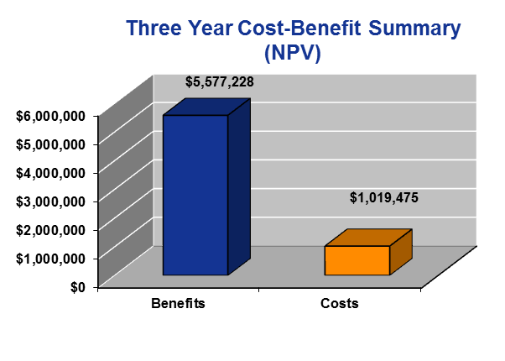
ROI & Payback Summary
Example is based on 1,000 concurrent sessions of Fusion Live Assist with Palettes
Net Present Value (NPV) rate assumed to be 10%

Slide 4
Benefit Calculations

Slide 5
Reduced Cost Per Agent Call
Benefit #1
CaféX Fusion reduces cost per agent call due to enhanced live assistance & user context capture. Benefits include:
Reduced service call duration
Improved agent productivity factor (time spent with customers)

Slide 6
Calls That Continue on Current Channels
Benefit #1
Model assumes that a given percentage of inbound calls to the contact center in Years 1, 2, and 3 respectively will continue to use traditional (e.g. PSTN) channels and not be initiated from within the web/mobile app.

Slide 7
Improved FCR for In-App Live Assist Calls
Benefit #1
From Slide 3
From Slide 2
Model assumes that adding another channel (in-app communication) to the contact center will increase call volumes as shown above.
First call resolution improves each year due to in-app live assist which enables more effective agent interactions with customers

Slide 8
Net Savings in Agent Costs
Status Quo
Benefit #1
With CaféX Fusion
+
=
Net Savings

Slide 9
Reduced 800 Charges
Benefit #2
Year 1: 10% of Inbound Calls Avoid PSTN Charges
Year 2: 20% of Inbound Calls Avoid PSTN Charges
Year 3: 30% of Inbound Calls Avoid PSTN Charges

Slide 10
Travel Cost Savings Calculation
Benefit #3
Enterprise experts will be able to connect directly to customers via in-app video & live assistance from anywhere without traveling to different locations.
Travel Cost Savings | Low Estimate | High Estimate
Average annual travel expenses per expert | $5,000 | $15,000
Number of experts traveling | 100 | 100
Percentage of travel avoided with CaféX Fusion | 30% | 40%
Travel cost savings per year | $150,000 | $600,000

Slide 11
Revenue & Margin Uplift
Benefit #4
Enterprise experts can utilize CaféX Fusion to intersect customer transactions at the point of sale to recover leads, increase sales conversion rate and create cross-sell/upsell opportunities.
Annual Benefit | Estimate | High Estimate
Leaked Leads Recovered Per Branch | $50,000 | $200,000
Sales Conversion Improvement Per Branch | $60,000 | $250,000
Increased Cross-Selling/Upselling Per Branch | $6,000 | $30,000
Total Incremental Revenue per Branch | $116,000 | $480,000
Number of Branches to Deploy CaféX Fusion | 10 | 10
Total Incremental Annual Revenue (All Branches) | $1,160,000 | $4,800,000
Total Incremental Margin (Assume 10% Operating Margin) | $116,000 | $480,000

Slide 12
Business Case Details

Slide 13
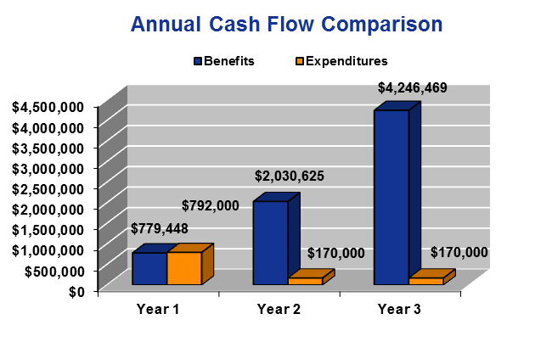
Results Summary

Slide 14
Results Summary

Slide 15
Thank You

