Slide 1
Market Data Master Deck
<Speaker >
June | 2015

Slide 2
Use this deck in conjunction with the CaféX Overview & Case Studies & Use Cases decks to customize a customer presentation based on the appropriate vertical

Slide 3

Web & mobile are the new face of customer engagement
Customers
4X
more likely to defect if issue is service-related
Bain & Company
74% use 3+ channels for service issues Ovum
60% opt for mobile self-service as first option Gartner
58% companies don’t measure cross-channel journey Forrester
Over 2 million mobile apps in market
Forbes
Notes:
A customer is 4x more likely to defect to a competitor if the problem is service-related rather than product or price related. Ovum
By 2015, at least 60% of Internet users will opt for mobile customer service as their first option
Gartner, Predicts 2014: Customer Support & the Engaged Experience
58% of companies don’t measure their customers’ cross-channel journey.
Forrester, The State of Customer Experience Management, 2013
Other Stats:
Over 72% of users
would replace customer channels with a mobile app
http://readwrite.com/2011/11/09/infographic-mobile-apps-and-cu
80% of customer service interactions now no longer involve talking to an employee.
Gartner, The Four Attributes of Customer Engagement
90% of companies had disparate communication channels: phone, email, chat, web-self-service.
Forrester Research, survey of 279 contact center decision-makers

Slide 4








Enterprise Value Proposition
Higher Revenue, Loyalty & NPS
Channel Choice, Protect Investments
  360°customer view
  Higher cross-sell & up-sell
  Channel escalation seamless, continuous
  Real-time analytics
Integrate existing channels & back-end
One set of apps, one set of infrastructures
Cost Reduction & Productivity
Mobile & Video Adoption
  Higher FCR from contextual interactions
  Increased self-service saves $ millions per year
Preserve UX with in-app one-click video
Use existing endpoints
Mobile push notification

Slide 5
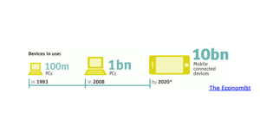
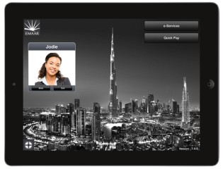
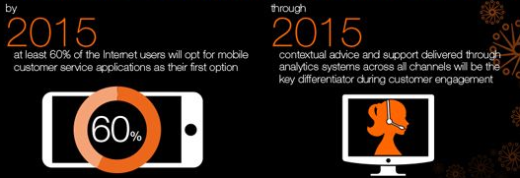
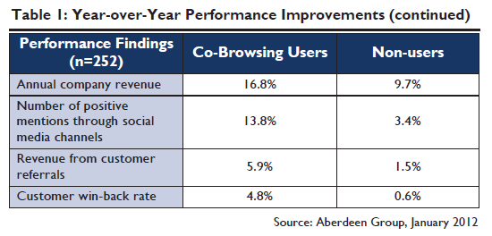


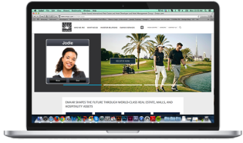
Trends: Mobile, Video, Co-Browse, Chat & WebRTC
1. Proliferation of mobile apps
3. Changing face of customer engagement
13M ANDROIDS A DAY & 4 IPHONES PER SECOND
52% of companies planning to introduce 2+ B2C apps in next 6mos
S1.2B or 50% of global workers to be mobile by 2014
84% of CIOs say mobility is their top focus for 2014
Customer experience management market at 19.8% CAGR thru 2017
60% of CIOs will focus on improving customer experience in 2015
2. Co-browse & web chat drive business benefits
4. Video becoming pervasive & WebRTC on the rise
Video will exceed 91% of global consumer traffic by 2014
18% of managers plan to introduce video in next two years
Video chat with expert is a top priority in 2014 – Call Center Trends 2014
4.6 billion WebRTC compatible mobile devices in 2016
Total market for web chat is ~50M websites, assuming over 1.5M chat users today and 3% of websites enabled with live chat (reference)

Slide 6
Mobile & Video

Slide 7

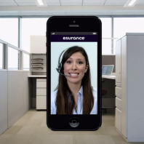
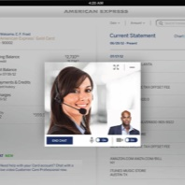
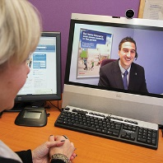
Mobile & Web are the New Face of Business
FACTS
Over 90% of users would replace customer channels with a mobile app
By 2015, at least 60% of Internet users will opt for mobile customer service as their first option
Desk.com
live video & co-browse
Esurance
video claims appraisal
Amex
video chat in tablet app
Nationwide Now
remote mortgage advisor
Sources: Gartner, ClickFox
Notes:
Mobile & web are becoming the face of most businesses.
Other stats:
90% conversion rate when video channel added versus 50% for audio only Forrester
16.8% annual revenue growth for firms that include co-browse versus 9.7% for ones that don’t
Aberdeen
Over 90% of users would replace customer channels with a mobile app

Slide 8

When App Users Need Help from a Live Person
PROBLEM
High friction experience App users must switch channels
Install plugins
Download software clients
Disconnected journey
App context is not correlated
Users must repeat details
No visibility within CC, CRM & IVR

Slide 9

Mobile in Customer Service
Mobile Channels to have growing impact on overall customer experience over next 10 years
Less than 10%
of global enterprises
are prepared to
support the
mobile customer
2016
2017
Customers will expect at least 65% of all customer support issues to be addressable on their mobile devices.
35% of all customer support will take place on a mobile device, an increase of 300%.
(Source: Gartner July, 2014)
Notes:
Based on customers’ different mobile priorities depending upon who they are doing business with, the statistics show that more and more issues need to be addressed via a mobile device but less than 10% of enterprises are prepared to do so.

Slide 10
Gartner Contact Center Predictions
By 2015 at least 60% of the Internet users will opt for mobile customer service applications as their first option
Contextual advice and support delivered through analytics systems across all channels will be the key differentiator during customer engagement

Slide 11
Video Traffic is Growing Rapidly
The global online video community surpassed 1 billion users by the end of 2010
Video will exceed 91% of global consumer traffic by 2014
52% CAGR
Petabytes per month
Video is here.
Source: Cisco Visual Networking Index, 2009
Notes:
11
Aging populations, a shortage of healthcare practitioners, and rising costs continue to be key challenges in healthcare. Healthcare organizations are increasingly looking to technology innovations and alternate healthcare delivery models to improve patient care while trying to address these challenges.
Findings that support these bullet points:
Rising patient load, especially the elderly and those with chronic diseases
Populations around the world are growing, people are living longer, and, in the U.S., baby boomers are nearing retirement.
The number of baby boomers entering a classifiable disease risk category is increasing by 6% annually. (Frost & Sullivan, 9/08)
More than 90 million Americans live with chronic illnesses (asthma, congestive heart failure, diabetes, hypertension, etc.). The annual medical cost of caring for these patients is more than 75% of total healthcare expenses (U.S. Centers for Disease Control and Prevention).
Shortage of medical professionals
The Journal of the American Medical Association reports a steady decline in the number of US medical student graduates choosing primary care.
In the U.S., the ratio of healthcare staff per citizen is lower than the required amount by more than 40 percent. Staff demands are expected to double over the next 25 years and the crisis is expected to peak between 2010 and 2020. (Frost & Sullivan, 9/08)
Rising cost of providing care
In the U.S., total health spending per person in 2007 was USD 7,439 (Medicare and Medicaid Office).
According to the Organization for Economic Co-operation and Development, healthcare spending in 2007 accounted for:
16% of GDP in the U.S.
10.7% of GDP in Germany
9.7% of GDP in Canada
9.5% of GDP in France
These costs are projected to continue to increase over the next decade.
ERs & EDs are overcrowded and often a patient’s first choice for care
In the U.S., 1 in 3 emergency rooms (ERs) and emergency departments (EDs) are so crowded that ambulances are sometimes diverted to other hospitals. In urban hospitals, the number is 1 in 2. (American Hospital Association)
The uninsured often use ERs/EDs as their primary source of healthcare. Research shows that more insured patients are also using ERs/EDs because it’s inconvenient to see their regular care provider (US Community Tracking Household Study Household survey)
Overuse of ERs/EDs adds cost to an already overburdened healthcare system
Specialists aren’t always available locally
Patients in remote and rural areas often have to travel (sometimes very long distances) to see a doctor or specialist

Slide 12
Trends
Appccelerator: Enterprises predict that 2014 will be the year when the number of new mobile applications will surpass the number of new desktop applications.
Adults in the U.S. are expected to spend an average of two hours and 21 minutes a day on smartphones and tablets this year, excluding time spent talking on phones, according to a recent study by eMarketer.
Appccelerator: 73 % of enterprises have built fewer than five applications, and 39 % have built none or just one
Mobile-ad spending in the U.S. totaled $3 billion in the first half, up from $1.2 billion a year earlier, the Interactive Advertising Bureau estimates.
Mobile continues to be an inexpensive way to advertise versus online and TV
Notes:
http://www.wired.com/insights/2013/02/why-your-enterprise-must-rethink-mobile-app-development/
http://ovum.com/press_releases/ovum-reveals-firms-face-huge-security-risks-as-80-of-byod-goes-unmanaged/
COMPETITION IBM WIRLWIND PRIVATE APP STORE
http://www.appcelerator.com.s3.amazonaws.com/pdf/enterprise-report-q12013-final.pdf

Slide 13

Mobile & web apps will be the face of customer service
Number of Mobile
Applications
in Market
81% of consumers use the phone for support but only 8% feel they receive excellent service
30%+ of customer calls are transferred to an agent on average
72% would replace traditional phones with mobile apps if the same customer features were available
Apple iOS:
1.2 Million
Native to iPad
600,000
Android:
1 Million
Forbes
Notes:
Forbes reference is from http://www.forbes.com/sites/chuckjones/2014/06/11/androids-app-engagement-higher-than-ios-but-apple-drives-higher-ecommerce-sales/.
The telephone is arguably the most important channel that needs improvement. The majority of people (81%) prefer the phone for support, yet only 8% of consumers feel they are provided with ‘excellent’ customer service. This is the biggest gap out of any interaction channel, and the reason why we expect more from call centers (Top 10 Call Center Trends 2013)
30% of calls transferred to an agent was data given to us by two prominent financial services customers
Third stat on 72% : https://fonolo.com/blog/2013/02/6-smartphone-app-statistics-for-your-call-center-to-consider/

Slide 14
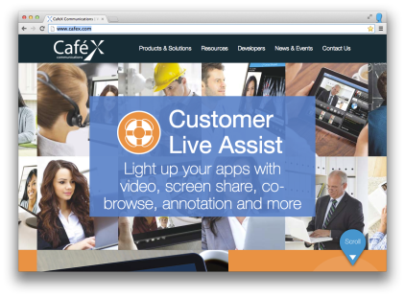


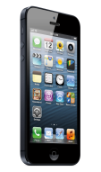
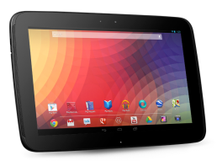




Mobile & Web Real-Time Customer Engagement
  2013
  1.3 billion smartphones world-wide¹
  62% of US mobile are smartphones²
  35% of US owns a tablet³
  1.2 billion WebRTC enabled browsers
Tomorrow
  3.1 billion smart phone devices (2017)¹
4.7 billion mobile WebRTC Devices by 2018⁴
By 2016, 36% of inbound customer service calls will be made from smart phones (Ovum, 2012)

Slide 15


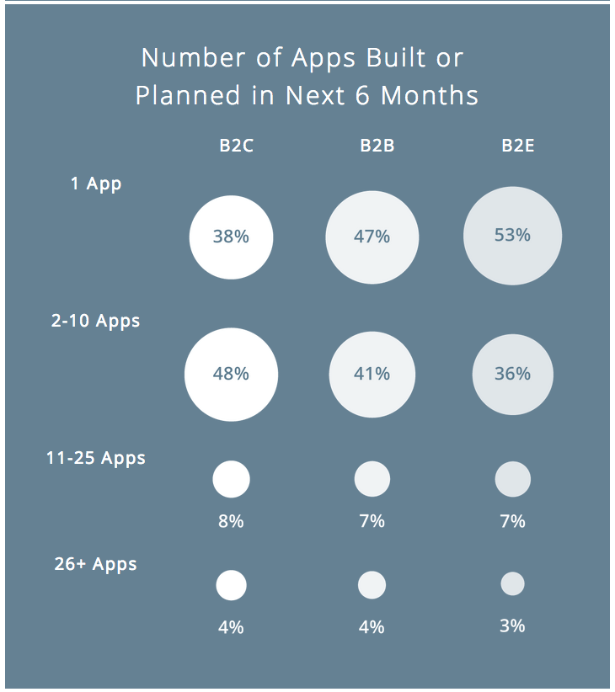

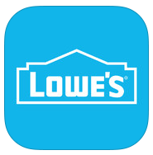




Enterprise Mobile Apps
    70 billion app downloads in 2013
48% of respondents report using mobile apps more than 10 times a day
565.4 M app users by end of 2016
46% of organizations are developing two or more business-to-employee, 52% plan to build two or more business-to-business applications applications in the next six months
Over 90% of respondents would replace some or all traditional customer service channels with a mobile app
15
Notes:
70 billion app downloads in 2013 – 58 billion to smartphones and 14 billion to tablets (ABI research, 2012)
48 % of respondents report using mobile apps more than 10 times a day (Clickfox, 2011)
565.4M app users by end of 2016 (Portfolio Research, 2012)
46% of organizations are developing two or more business-to-employee, 52% plan to build two or more business-to-business applications applications in the next six months (Appcelerator)
Over 90% of respondents would replace some or all traditional customer service channels with a mobile app (ClickFox, 2013)

Slide 16

Proliferation of Mobile Devices
13 MILLION ANDROIDS A DAY
4 IPHONES PER SECOND
The Economist
Notes:
http://www.economist.com/node/%2021531109

Slide 17
Trends for Mobile Applications
Appccelerator: Enterprises predict that 2013 will be the year when the number of new mobile apps will surpass the number of new desktop apps
Adults in the U.S. are expected to spend an average of two hours and 21 minutes a day on smartphones and tablets this year, excluding time spent talking on phones, according to a recent study by eMarketer
Appccelerator: 73 % of enterprises have built fewer than five applications, and 39 % have built none or just one
Mobile ad spending in the U.S. totaled $3 billion in the first half, up from $1.2 billion a year earlier, the Interactive Advertising Bureau estimates.
Mobile continues to be an inexpensive way to advertise versus online and TV
Notes:
http://www.wired.com/insights/2013/02/why-your-enterprise-must-rethink-mobile-app-development/
http://ovum.com/press_releases/ovum-reveals-firms-face-huge-security-risks-as-80-of-byod-goes-unmanaged/
COMPETITION IBM WIRLWIND PRIVATE APP STORE
http://www.appcelerator.com.s3.amazonaws.com/pdf/enterprise-report-q12013-final.pdf

Slide 18


Companies’ Internal Mobile Applications
Currently has 3 client facing and 30-50 business facing apps
Expects to have 500 employee-facing apps by 2015,”
Michael King - Appccelerator
Notes:
http://www.economist.com/node/%2021531109
http://www.cio.com/article/737349/CIOs_Say_Mobilizing_Enterprise_Apps_Is_Not_That_Easy
Webalo report : http://www.webalo.com/pdf/infographic1_15_2013.pdf
http://www.wired.com/insights/2013/02/why-your-enterprise-must-rethink-mobile-app-development/

Slide 19
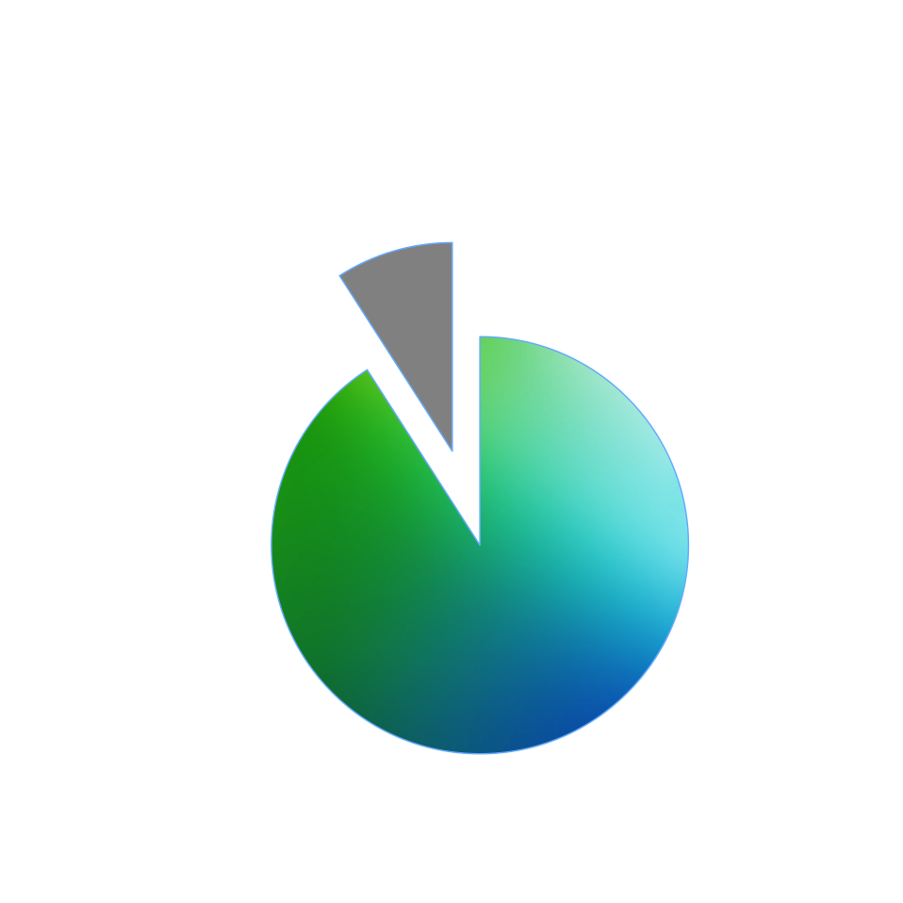
Total Addressable Market for Mobile Apps
Target Fortune 2000 companies
Assumption : 20 apps/company
Price : 1M per app or 5M/company
5-10B$ Enterprise class apps
30B$ Non enterprise class apps (ABIResearch)
Source : Forbes, Appcellerator, ABIResearch
Notes:
https://www.abiresearch.com/press/cumulative-mobile-app-revenues-set-to-exceed-30-bi
http://techcrunch.com/2011/12/23/flurry-largest-addressable-markets-for-mobile-developers-in-2012-include-india-china-japan-u-s/
http://arstechnica.com/business/2011/11/private-app-stores-does-your-company-need-its-own/

Slide 20
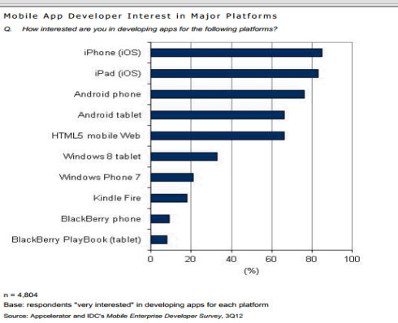
Impact of Mobility on IT Spending
$2.1 Trillion IT Spend
IT Market Growth YoY
Tablets & smartphones to drive almost 60% of market growth
Mobility
20%
Everything Else
With Mobile Smart Devices
Without
Mobile App Development
Mobile Users in US
Mobile app platforms with less than 50% of developers interested in building apps are vulnerable
Millions of users
Mobile users to surpass PC users by 2015 in US
2016
2012
Notes:
http://www.networkworld.com/news/2012/113012-idc-predictions-264702.html?page=1
In the big picture, IDC says worldwide IT spending in 2013 will exceed $2.1 trillion, up 5.7% from 2012. The biggest driver of that growth will be mobility: Sales of smart mobile devices including smartphones and tablets will grow by 20%, generate 20% of all IT sales, and drive a whopping 57% of all IT market growth. Excluding smart mobile devices, IT industry growth will be just 2.9%.
http://www.idc.com/research/Predictions13/downloadable/238044.pdf

Slide 21
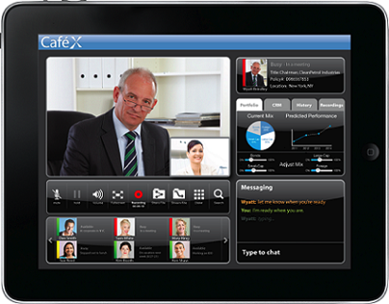
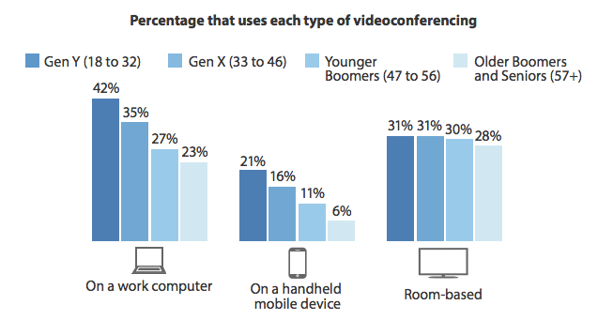
Deeper & More Personal Experience Thru Video
34% of respondents stated that video conferencing with online buying or support environments would help
36% indicated that video for remote inspections of items/designs would assist in operations
15% of North American and EU information workers used videoconferencing on mobile devices for work-related calls
18% of Contact Center managers plan to introduce or upgrade to video in the next two years
Forrester Research, Inc., Workforce Employee Survey, Q4, 2012
Notes:
34% stated that video conferencing in online buying or support environments would help them, 36% indicated that video for remote inspections of items/designs would help them (2013 Wainhouse Research, LLC)
Forrester Research, Inc: 4,938 NU & EU technology information workers who have access to video conferencing (Workforce Employee Survey, Q4, 2012)
Forrester Research, Inc.: Next-Generation Contact Centers Must Become Relationship Platforms Strategies To Keep Pace With The Social Customer February 2011)

Slide 22





CaféX Fusion Market Opportunity
1. Proliferation of Mobile
3. Changing face of the Contact Center
13 MILLION ANDROIDS A DAY ~1B IOS & 800M ANDROID APPS today
4 IPHONES PER SECOND 52% of companies to have 2+ B2X apps in 6mos
Mobile Apps for Mobile Customer Service 2. Big Data in Contact Center 3. Omnichannel 4. Social Source: CC Tech Trends 2014
2. Video Chat for Customer Service
4. Video is become pervasive
18% of managers plan to introduce Video in the next two years (Top 10 trends 2013)
Video Chat with expert is a top 10 priority in 2014 – Call Center Trends 2014
18% increase in the number of cloud-based agents thru 2016
4.6 billion WebRTC mobile devices in 2016
Source: Bubley Report

Slide 23



CaféX Alignment With Market Trends
WebRTC hype is justified. 3 billion capable devices and 1 billion users of WebRTC by end-2016. 50% penetration of PCs by end of 2013. Smartphone & tablet capability for WebRTC will ramp strongly from 2H 2014. – Dean Bubley WebRTC Market Status 2012
…Global smartphone shipments are expected to jump this year by 25% according to Digitimes Research. By 2015, IDC expects more US consumers will access the internet through smartphones than PC’s.
Video is making its way to the call center; thanks to the amount and detail of information it provides customers. In fact, 18% of managers plan to introduce or upgrade this emerging technology in the next two years – Top 10 Call Center Trends 2013
The telephone is arguably the most important channel that needs improvement. The majority of people (81%) prefer the phone for support, yet only 8% of consumers feel they are provided with ‘excellent’ customer service. This is the biggest gap out of any interaction channel, and the reason why we expect more from call centers (Top 10 Call Center Trends 2013)
Time to “Flip the Model” (from B2C to C2B) - An app on smartphone that is tailored to help a person take control of the conversation is ideal. It provides mobile users with tools to indicate where they are, what they’re looking for and how they want to be reached. Brands and enterprises should enthusiastically embrace smartphones (and tablets) as a primary customer service platform - Dan Miller, Opus Research (2012)
Notes:
CRM Market growth in 2012 was three times the average for all enterprise software, highlighting how CRM is at the eye of the Nexus of Forces storm - Correia, VP Gartner
Gartner Magic Quadrant report for CC:
rowing interest in adding tighter linkage between customer service operations and mobile applications — Mobile applications can provide customers with easier access to self- service information by supporting a visual interface to option selections and data that previously was available only to those accessing the company using a more traditional computer interface. These solutions can also provide customers with additional information and options based on real-time information regarding contact center operations, such as expected wait times and callback options. Mobility can also be used for internal-facing applications, such as providing real-time and historical performance dashboards and access to staffing and monitoring capabilities, while the contact center manager or director is away from his or her desk.
Gartner reported that the market for CRM software surged by 12.5 percent in 2012. Last year, CRM vendors hauled in $18 billion in revenues, compared to $16 billion in 2011
Gartner 2013 - Customer relationship management (CRM) has edged past enterprise resource planning (ERP) as the top application software investment priority. This further validates a business focus on enhancing customer experience, with both mature and emerging regions emphasizing investments in CRM. Survey respondents indicate that their top three application software investment initiatives for 2013 are CRM, ERP, and office and personal productivity tools.
When it comes to business applications, CRM is clearly outpacing the rest of the industry. "Market growth in 2012 was three times the average for all enterprise software, highlighting how CRM is at the eye of the Nexus of Forces storm," added Correia (Gartner VP)

Slide 24
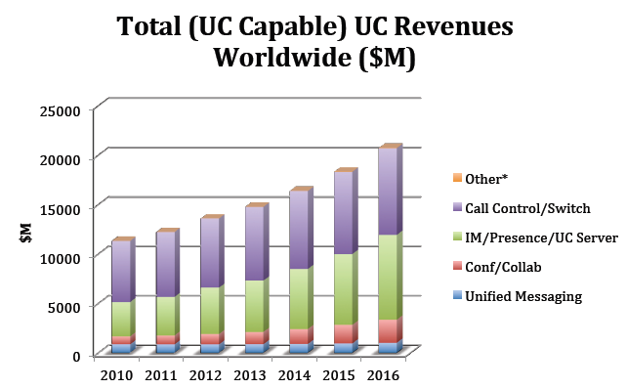
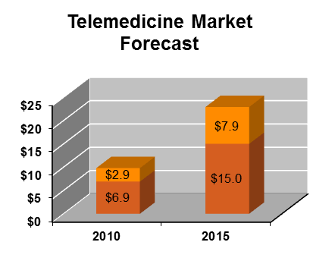
UC, Mobility & Video Collaboration Market Sizing
CoMMFusion LLC & UC Strategies
    UCC Market Data
    UC Apps market to grow 18.3% to $44 billion by 2015, up from $19 billion in 2010 (IDC)
1.2B or 50% of global workers to be mobile by end of 2013
11.2% CAGR over 5 years
17% for Conf/Collab & 14% for IM/P/UC
$22.9B
Telehome
$9.8B
Telehospital
Transparency Market Research
The UC market was valued at $22.8B in 2011 & expected to grow at a CAGR of 15.7% from 2012 to 2018 to reach $61.9B
18.6% CAGR over 5 years
24
Notes:
Telemedicine Market Report: Transworld News http://transworldnews.com/NewsStory.aspx?storyid=1210290&utm_source=twitterfeed&utm_medium=twitter&utm_campaign=Feed%3A+TransWorldNewsCurrentReleases+%28TransWorldNews+Current+Releases%29
Unified Communications & Collaboration Market 2011 – 2016
COMMFusion LLC & UC Strategies
Telemedicine growth driven by best practices for healthcare cost reduction:
Outsourced medical services
Home-based treatment
Intervention instead of post treatment
Integrated IT environments
Increased resource efficiency
The unified communications market was valued at $22.8 billion in 2011 is expected to grow at a CAGR of 15.7 percent from 2012 to 2018 to reach $61.9 billion.
Transparency Market Research, "Unified Communications (News - Alert) Market - Global Industry Analysis, Size, Share, Trends and Forecast, 2012 – 2018."

Slide 25
WebRTC

Slide 26
WebRTC Market
WebRTC Market Status & Forecasts -The hype is justified: it will change telecoms – Dean Bubley, Feb 2013
Executive Summary excerpt:
  WebRTC adds easy, flexible voice & video into websites and apps
  - Applicable to multiple sectors: telecoms, consumer web, enterprise comms etc
  - One of the most disruptive & important web/telecoms innovations for years
  - Extremely fast pace of evolution: weeks and months, not years
  - Microsoft & Apple slow to adopt, but unlikely to cause major roadblocks
  - PCs adopt WebRTC through browser updates; phones/tablets are more complex - Early use-cases for web calling, conferencing, e-learning & some verticals
  - Peer-to-peer use of WebRTC likely to drive unexpected new web innovations
  - Monetization of WebRTC will be heavily use-case dependent
  - Still very early, with pre-standard implementation but hype is justified
3 billion capable devices and 1 billion users of WebRTC by end-2016
50% penetration of PCs by end of 2013
Smartphone & tablet capability for WebRTC will ramp strongly from 2H 2014
Notes:
Agenda

Slide 27
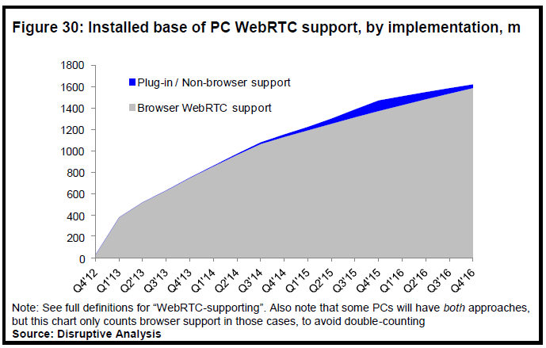
WebRTC Market – PC Adoption
Prediction: 50% of PCs (750m) will have WebRTC-supporting browsers by the end of 2013, and 71% (1100m) by the end of 2014

Slide 28
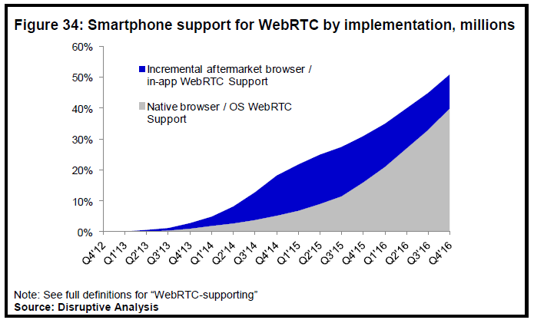
WebRTC Market – Smartphone Adoption
First cut estimate only - adoption of WebRTC within mobile devices is more difficult to predict because there is much less clarity about the timelines for support in mobile browsers and OS’s.

Slide 29
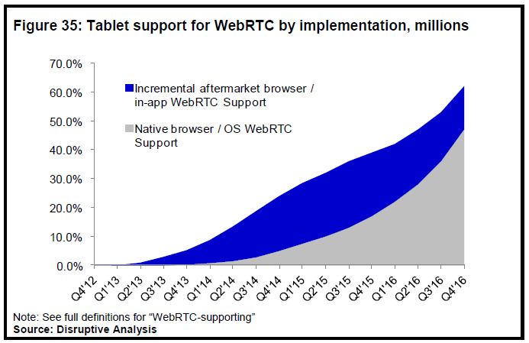
WebRTC Market – Tablet Adoption
First cut estimate only - adoption of WebRTC within mobile devices is more difficult to predict because there is much less clarity about the timelines for support in mobile browsers and OS’s.

Slide 30
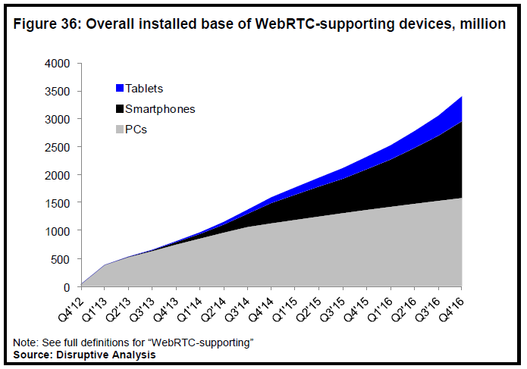
WebRTC Market – Overall Adoption

Slide 31

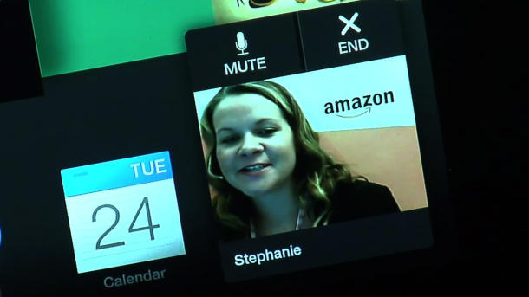
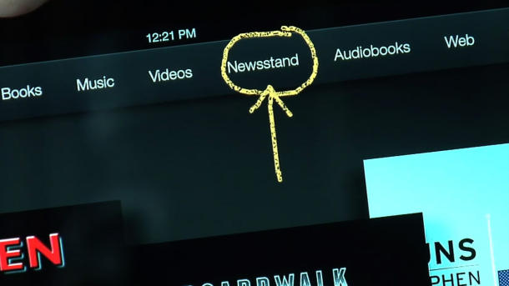
Sample Proof Point: Amazon Kindle HDX “Mayday”
4th Gen Amazon Kindle HDX allows real-time communications (via camera & microphone)
Launched Oct. 18th, 2013
24 x 7 live assistance with “Tech Advisor”
15 second connect (Wi-Fi only)
Features:
  Live video
  One-way video; two way HD audio
  Small, movable video window
  User/Agent Screen sharing (Pause/Resume)
  Agent screen control (Scroll, Click)
  Annotation (Pen Drawing)

Slide 32
Unified Communications

Slide 33
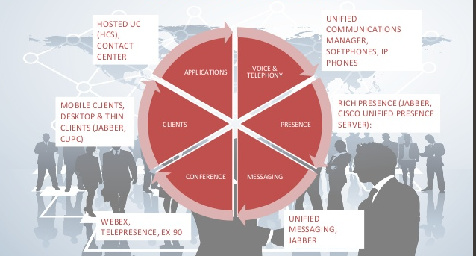
UC Solution Areas

Slide 34
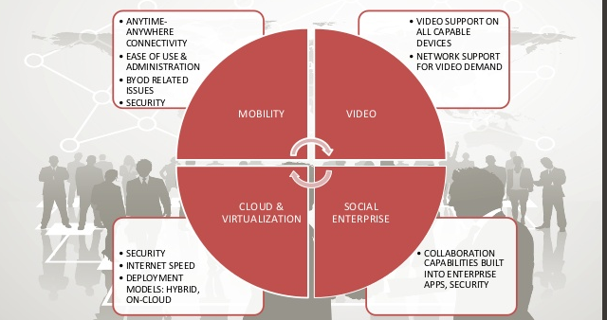
Major Trends & Challenges

Slide 35
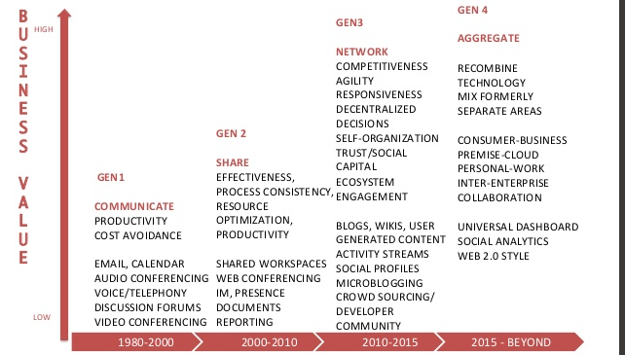
Evolution of UC

Slide 36
Contact Center & Customer Experience Management

Slide 37


Companies Aren’t Yet Ready to Deliver
What Customers Want
73%
of consumers think
brands pay more attention
to generating sales across multiple channels than they do
to providing an integrated customer service experience.
25%
Nearly of mobile phone, health insurance, and retail bank customers wish their providers offered video chat tools for customer service.
89%
of consumers want personalization,
18%
but only see it frequently from retailers.
Sources: Vibes; TeleTech, “Mobile Customer Expectations study,” May 2015; Zendesk, “The omnichannel customer service gap,” November 2013.
Notes:
Customers want personalization, and integrated customer service experience and feel that the companies they deal with pay more attention to generating sales then the experience. Frustration, frustration, frustration.

Slide 38
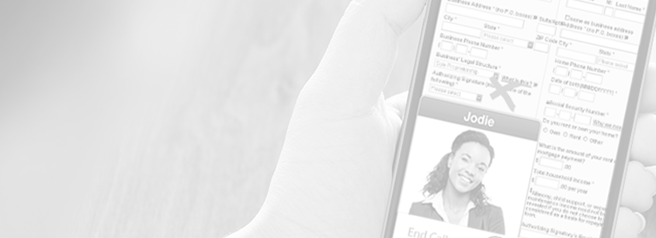
What Do Customers Really Want?
Invest in in-app customer service to avoid frustration
Accessibility
Ease
Self-service
Answers
HELP!
Remarkable Experiences!
47%
51%
44%
are leaving the
app to make phone
calls to get help.
are leaving the app to email for help
actively dislike leaving the app
Mobile Spend in 2015, Contact Solutions
Notes:
So what do customers want? We stated earlier that they wanted personalization and an integrated customer experience, but why? When you get down to the heart of the matter, people just want help. When you as a customer need to contact a company you do business with, it’s because you usually need help. Help to replace a missing/broken part, help to question a charge on your credit card, whatever it is and how complicated it is, you want to make it as painless as possible to get the help you need.
Accessibility – people always have their phone on them – enterprises should take advantage of that convenience
Ease - Idea of personalization comes into play here – each person has a different need (ease or complicated). Whole range of personalization – people are expecting that and convenience
Self-service - You should have all of my information – name, contact info, etc. Don’t want to “re-hash” my information every time I’m moved through
Answers – the ability to find the answers to help me because having to call you, is the last thing I want to do.

Slide 39
Enterprise Challenges
Customer Engagement is Lacking
Technology is Shifting
Mobile is dominating engagement
and interactions
No contextual information
Customer story requires more personal touch = higher conversion, better customer service (example: Amazon Mayday)
In 10 years,
a majority
of interactions
will migrate
to in-app
Plug-ins going away
Mobile apps proliferate with customers and inside enterprise
Context from Internet
WebRTC vs. legacy UC & contact center systems
Notes:
So, what are the challenges?
Rise of enterprise apps
1. Average of 400 applications per large enterprise (Vanson Bourne / Mobile Helix; Dec. 2013)
2. 30% of enterprise apps are web based & 6% are mobile (Citrix Mobility Report; Dec. 2013)
Growth of WebRTC
1. Over one billion WebRTC enabled browsers in use in 2013, in contrast, it took the mobile phone industry 18 years to grow to 1 billion subscribers. (Dean Bubley WebRTC Market Status)
2. With mobile support, this will reach 4.7 Billion Mobile WebRTC Devices by 2018 (ABI Research, Sept. 2013)
3. There are over 9 million JavaScript programmers globally (Oracle 2014)
Contact center trends from Frost & Sullivan for 2014:
1. Mobile Apps for Mobile Customer Service 2. Big Data in Contact Center 3. Omnichannel 4. Social Source: CC Tech Trends 2014 http://www.nearshoreamericas.com/tech-trends-dominate-contact-center-industry-2014/
Plug-ins going away:
Support for browser plugins is waning due to ongoing security & compatibility concerns. For example, Google & Mozilla are terminating support for the Netscape Plugin API and plugins in 2014 . For Internet Explorer 10 and 11, Microsoft has issued a statement of direction without plugins. In turn, plugin warnings will appear with every use unless in "enterprise mode" or "desktop mode". This points to a transition period to migrate Internet Explorer users off of plugins for future versions of Internet Explorer. In addition, plug-ins are not allowed on Chromebooks.
Lucian Constantin, “Google Chrome to block and banish plugins built using popular NPAPI architecture”, PC World, September 24, 2013 (http://www.pcworld.com/article/2049309/chrome-will-block-npapi-plugins-over-stability-security-concerns.html)
Zach Walton, “Firefox To Soon Block Plugins By Default”, WebProNews, September 25, 2013 (http://www.webpronews.com/firefox-to-soon-block-plugins-by-default-2013-09)
Internet Explorer Dev Center, “Get ready for plug-in free browsing” Microsoft Corporation (http://msdn.microsoft.com/en-us/library/ie/hh968248(v=vs.85).aspx)
Other stats:
10 billion mobile connected devices by 2020 (Economist)]
52% of companies planning to have 2+ B2X apps in 6mos
90% of enterprise would replace traditional customer service channels with a mobile app (ClickFox, 2013)
By 2015 60% of Internet users will opt for mobile customer service applications as their 1st option (Gartner)
18% of managers plan to introduce Video in the next two years (Top 10 trends 2013)
Cost of interactions -

Slide 40



Today’s Mobile Customer Experience ….
Must leave
the app to call
IVR frustration
Context lost
(web to phone)
BROKEN USER EXPERIENCE
Customer engages
support via mobile web app
Live
Assistance
is required
Engages IVR
Customer data
re-entered via phone
Agent
re-directs
call to
different agent
Agent resolves customer issue
Customer frustration, rising agent costs, limited retention and loyalty
Notes:
In today’s world, and I’m sure you can all relate to this type of experience, you have an issue with a company you do business with, such as a retailer. Because you always have your mobile phone on you, You try to take care of it through the app on your mobile by logging in, to find out that you have to call the company directly to resolve the issue, which requires you to leave the app, go into an IVR, re-enter your information, explain your issue to an agent who then transfers you to another agent, where that agent may/may not resolve your issue. This broken user experience causes customer frustration, rising agent costs, and limited loyalty from the customer.

Slide 41
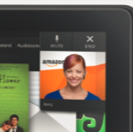

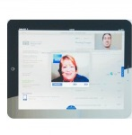
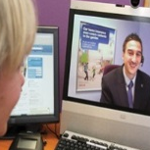
Market Transition & Drivers
In 2013, fewer than 5% of organizations worldwide had a mobile customer service strategy
Amazon Launches Mayday
By 2015, at least 60% of Internet users will opt for mobile customer service as their first option
Esurance video claims appraisal
Amex Launches live Video Chat
Organizations having adequate technologies and processes to provide a consistent customer experience across channels will grow from 2% to 20% from 2013 to 2015
Nationwide Now Mortgage Advisor
Gartner Predicts 2014 customer support and the engaged enterprise

Slide 42
Growing Customer Experience Market
CXM
19.8% CAGR through 2017
CC
4.8% CAGR through 2017
https://www.gartner.com/doc/2592117/forecast-contact-centers-worldwide-
http://www.marketsandmarkets.com/PressReleases/customer-experience-management.asp
Notes:
Because Contact Center growth as a market is less than 5%
Compared to Customer Experience Management (CXM) which as a market has already dwarfed traditional voice based contact center solutions and is growing at a CAGR of 20%
Gartner: https://www.gartner.com/doc/2592117/forecast-contact-centers-worldwide-
CC shipments expected to grow worldwide at 4.8% CAGR through 2017

Slide 43
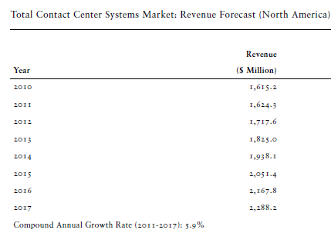
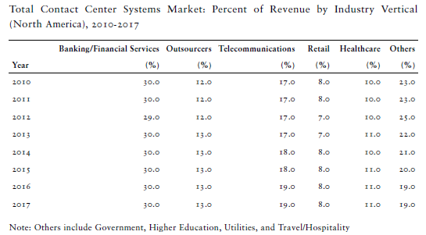
Contact Center Market Sizing (Premises-Based Systems in North America)
Category | 2011 Revenue | CAGR
Inbound CC | $850M | 4.7%
IVR | $200M | 6.3%
Analytics | $130M | 11.8%
Other categories include Outbound Dialer, WFM & QM
Cloud CC market worth $1.4B in NA with 11.6% CAGR
Frost & Sullivan 2012
43
Notes:
Frost & Sullivan NA Contact Center Market 2012
Frost & Sullivan Cloud Contact Center Market Trends:Movement from Best-of-Breed to Suites
The cloud model has seen unprecedented demand and growth in the contact center
market over the past few years. Frost & Sullivan values the total market comprising
best-of-breed and full-suite hosted and cloud contact center solutions to be worth
$1.4 billion in North America, growing at 11.6 percent a year. This represents the
combined spend across hosted and cloud-based ACD, IVR, outbound contact, chat,
quality monitoring, workforce management, and analytics applications.
In contrast, the corresponding market size for premises-based contact center
systems, based on product revenue, is $1.7 billion in North America, and growing
at 6.1 percent a year. While not exactly an apples-to-apples comparison, as
maintenance fees are excluded from the premises market size, it reveals a
significant market trend. The hosted/cloud model is not just a viable, but,
increasingly, a preferred model to deploy contact center technology.

Slide 44
Market Transition and Drivers
Expertise and Video Add Significant Business Value
70%
90% vs. 50%
2.5 vs. 1.4 products
Notes:
Now, why is this important for our customers, what value is it bringing, what problems is it solving?
Well. Look at these stats and think about your own personal shopping experiences:
Reduced Customer Abandonment
When no expert is available, 70% of customers/prospects will find alternatives
- Forrester Research
Improved Conversion Rates
90% with audio and video; vs. 50% with audio only
- Forrester Research
Increased Cross-Selling
2.5 products per customer with audio+video vs. 1.4 products with audio only
- Cisco Customer Feedback

Slide 45
Characteristics of Next-Gen Contact Centers
The next-generation contact center will have several important characteristics. It will be multichannel, multimedia, multiplatform, and social media fluent. It will operate with consistent information across all channels to enable deep personalization of customer interactions.
Notes:
Forrester Consulting Thought Leadership Paper Commissioned By Cisco Systems
Next-Generation Contact Centers Must Become Relationship Platforms
Strategies To Keep Pace With The Social Customer
February 2011
http://www.cisco.com/en/US/prod/collateral/voicesw/custcosw/next_generation_contact_centers.pdf

Slide 46
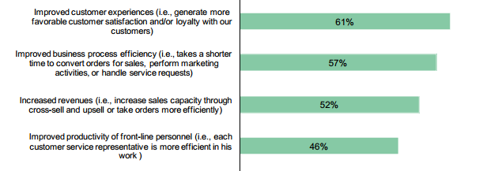
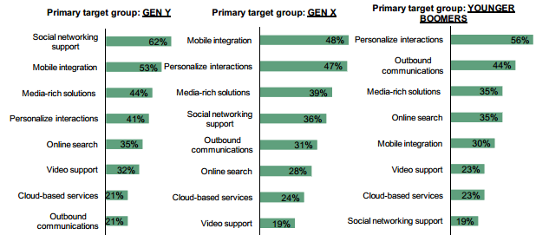
Characteristics of Next-Gen Contact Centers
Top Benefits Contact Centers Hope to Achieve in Next 24 Months
Generation-Specific Strengthening of Customer Interaction Capabilities
Notes:
Forrester Consulting Thought Leadership Paper Commissioned By Cisco Systems
Next-Generation Contact Centers Must Become Relationship Platforms
Strategies To Keep Pace With The Social Customer
February 2011
http://www.cisco.com/en/US/prod/collateral/voicesw/custcosw/next_generation_contact_centers.pdf

Slide 47

A Market in Transition Creates a HUGE Opportunity
“The blend of social media engagement with CRM software is evolving the contact center into the customer engagement center.” - Gartner
Budgets are moving from IT to the business, creating massive refresh cycle
“Mayday” from Amazon has helped to created market hype
Cisco #1 in Ability to Execute, per Steve Blood - Gartner
Bonus: Microsoft
Compete Advantage
Notes:
Whenever there is a market transition, there is an opportunity and if we execute well, we are in a great position to capture the momentum. But it requires action by us and your selves.
The following trends and facts almost create a perfect storm for us to deliver an omnichannel experience!
The importance of taking customer care from reactive to a pro-active relationship building opportunity is underlined by the fact that currently 50% of fortune 500 companies have a Customer Care representative at board level and that is up from 10% just 5 years ago.
With Mayday, Amazon has turned customer support into customer experience. Rather than force customers to navigate to a help page, search for information, and then navigate back and apply it, Mayday brings help directly to customers and delivers at their time of need. Turning tech support cost centers into potential profit centers. With the infrastructure in place for tech support, Amazon can easily leverage this capability for personal shoppers who help customers find just the right gift or for subject matter experts

Slide 48
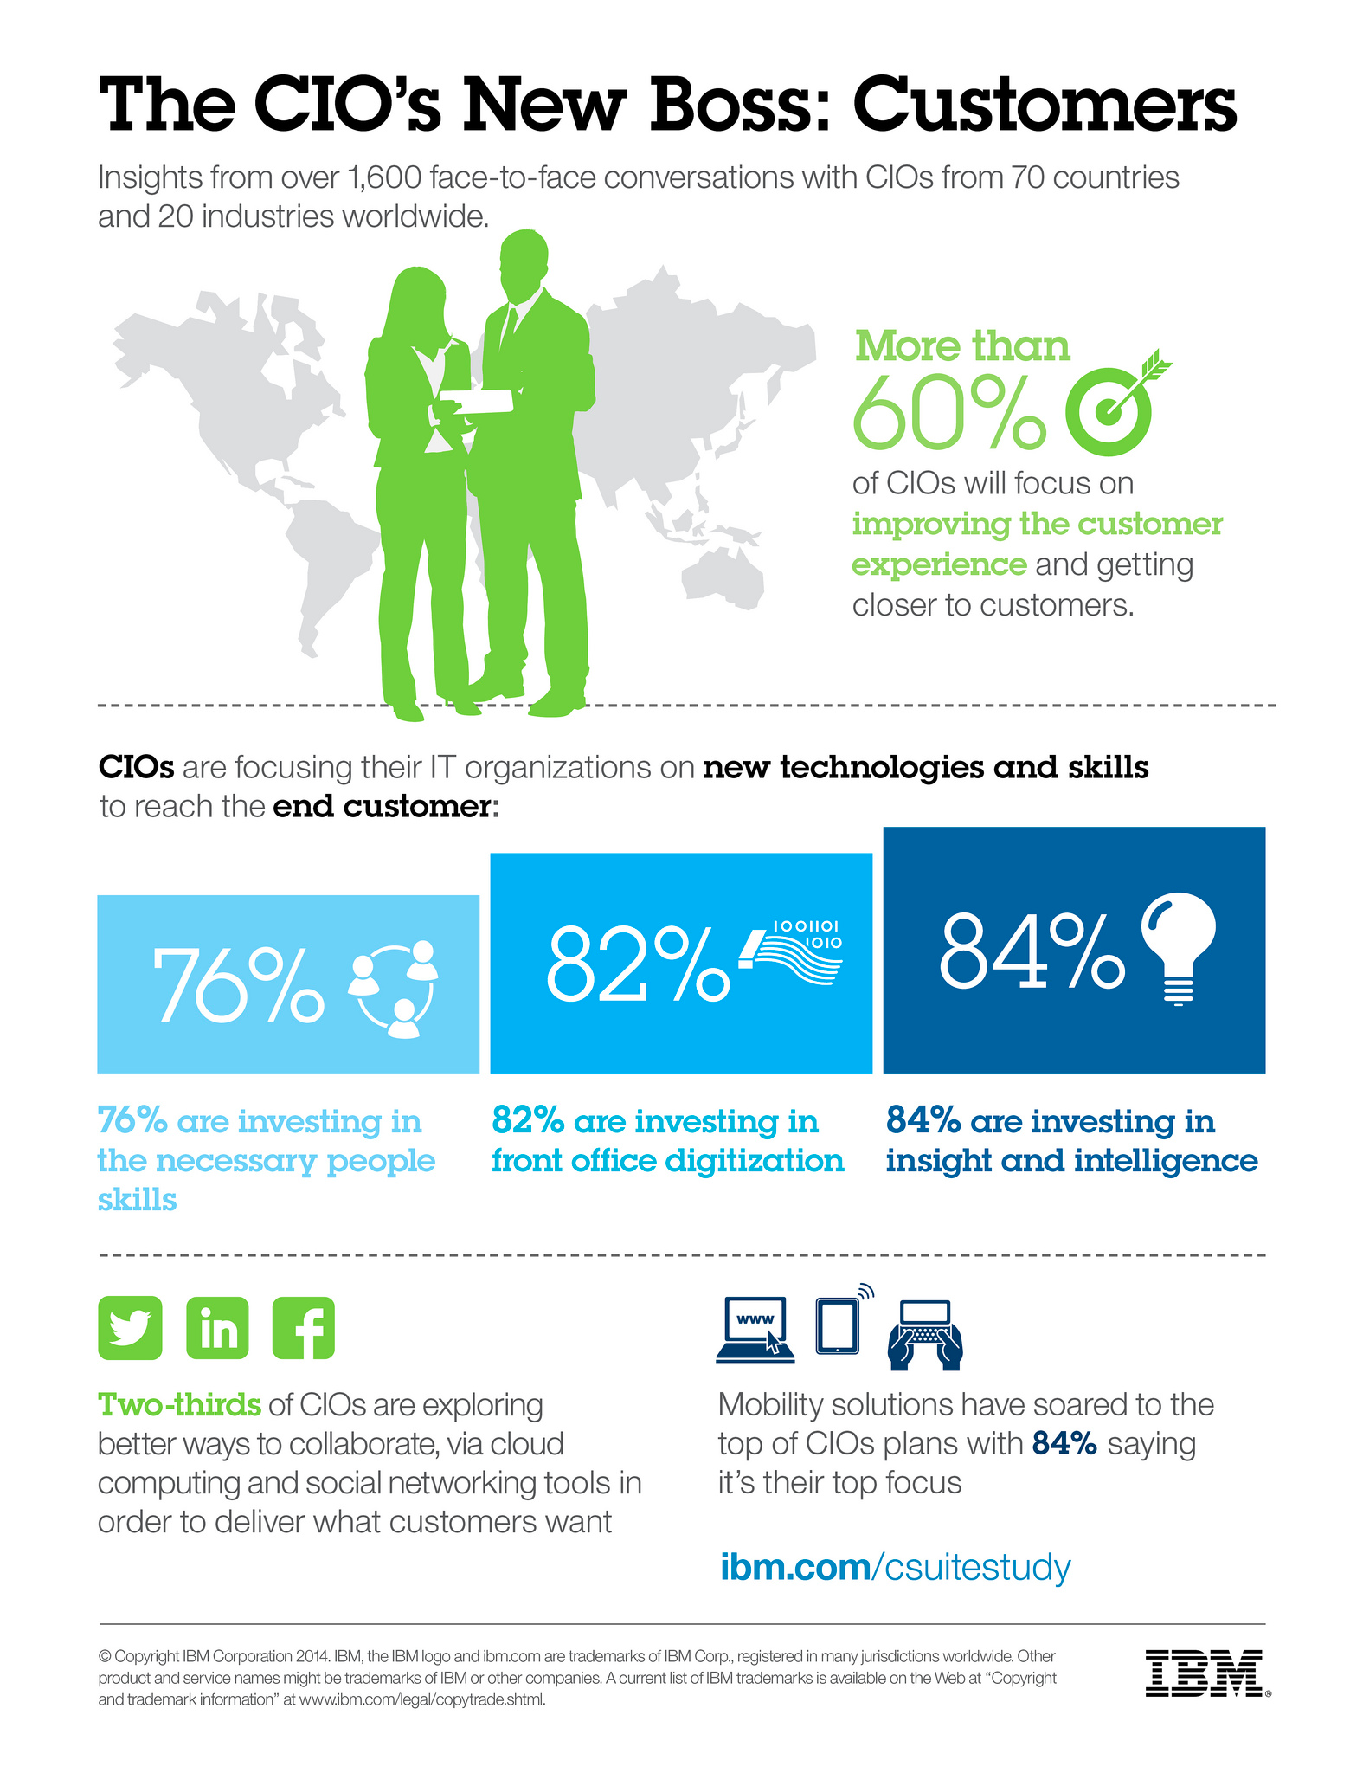
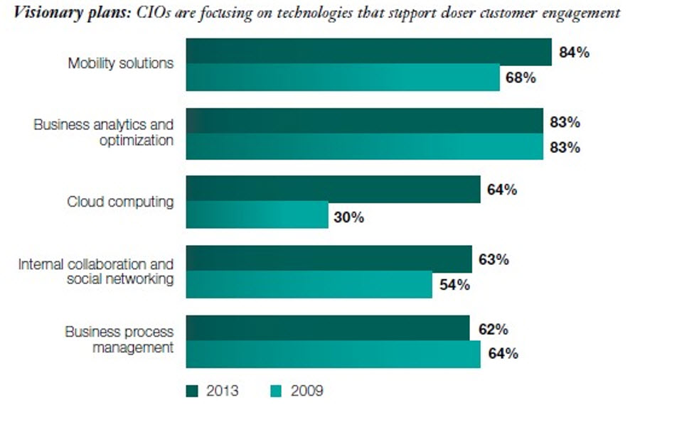

CIO’s Top priorities: Mobility Solutions & Improving Customer Engagement (IBM Research 2014)
Lines are blurring: CIOs not only want mobility solutions for their mobile work force but also to improve end customer experience (B2B/B2C)

Slide 49
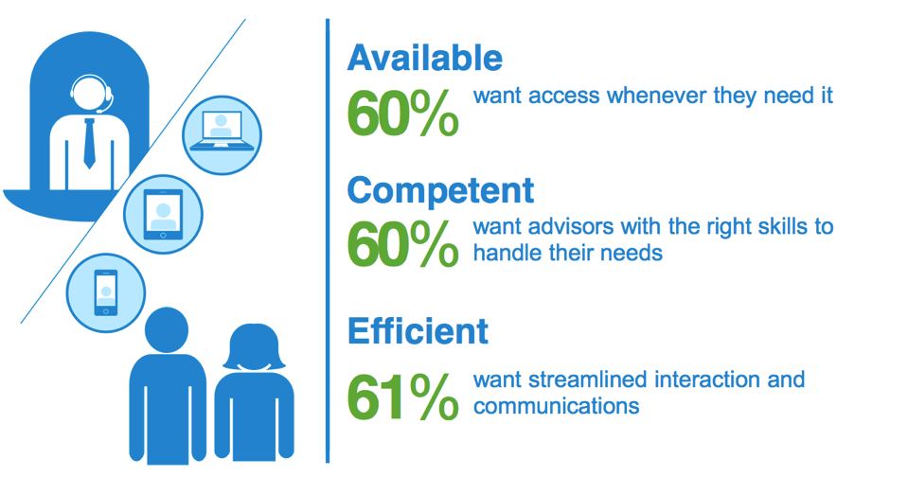
Opportunity: Customers Demand More Convenient Access
Top attributes consumers want from their healthcare provider
Notes:
49
Aging populations, a shortage of healthcare practitioners, and rising costs continue to be key challenges in healthcare. Healthcare organizations are increasingly looking to technology innovations and alternate healthcare delivery models to improve patient care while trying to address these challenges.
Findings that support these bullet points:
Rising patient load, especially the elderly and those with chronic diseases
Populations around the world are growing, people are living longer, and, in the U.S., baby boomers are nearing retirement.
The number of baby boomers entering a classifiable disease risk category is increasing by 6% annually. (Frost & Sullivan, 9/08)
More than 90 million Americans live with chronic illnesses (asthma, congestive heart failure, diabetes, hypertension, etc.). The annual medical cost of caring for these patients is more than 75% of total healthcare expenses (U.S. Centers for Disease Control and Prevention).
Shortage of medical professionals
The Journal of the American Medical Association reports a steady decline in the number of US medical student graduates choosing primary care.
In the U.S., the ratio of healthcare staff per citizen is lower than the required amount by more than 40 percent. Staff demands are expected to double over the next 25 years and the crisis is expected to peak between 2010 and 2020. (Frost & Sullivan, 9/08)
Rising cost of providing care
In the U.S., total health spending per person in 2007 was USD 7,439 (Medicare and Medicaid Office).
According to the Organization for Economic Co-operation and Development, healthcare spending in 2007 accounted for:
16% of GDP in the U.S.
10.7% of GDP in Germany
9.7% of GDP in Canada
9.5% of GDP in France
These costs are projected to continue to increase over the next decade.
ERs & EDs are overcrowded and often a patient’s first choice for care
In the U.S., 1 in 3 emergency rooms (ERs) and emergency departments (EDs) are so crowded that ambulances are sometimes diverted to other hospitals. In urban hospitals, the number is 1 in 2. (American Hospital Association)
The uninsured often use ERs/EDs as their primary source of healthcare. Research shows that more insured patients are also using ERs/EDs because it’s inconvenient to see their regular care provider (US Community Tracking Household Study Household survey)
Overuse of ERs/EDs adds cost to an already overburdened healthcare system
Specialists aren’t always available locally
Patients in remote and rural areas often have to travel (sometimes very long distances) to see a doctor or specialist

Slide 50

Visual Information Improves Patient Care
Video informed consent improved patient comprehension (78%) compared to verbal informed consent (65%) for knee arthroscopy¹
Video chemotherapy education improved retention of information and management of side effects²
Video improved sunscreen adherence and melanoma knowledge^{3,4}
Video-educated heart failure patients had better self adherence⁵
Source:
1 Guttman D, et al. Arthroscopy ,June 2005
2 Kinnare N, et al. European Journal of Cancer Care, July 2008
3 Idriss NZ, et al .Telemed J E-Health, December 2009
4 Loescher LJ, et al. Arch Dermatology, August 2010
5 Albert, NM, et al. Patient Education Council , December 2007

Slide 51





















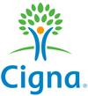














Companies Driving Business from NPS
Financial Services
Consumer & Retail
Industrial & Travel
a higher promoter score gives a 10% to 15% increase in spending and 4 to 5 times increased retention” Source: Ebay study, 2009 (link)
Healthcare
Technology
Media & Higher Ed

Slide 52
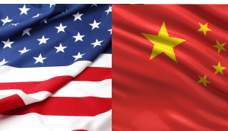
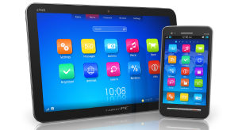

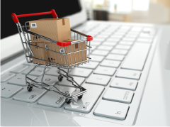
eCommerce Market Trends
China passed US in 2013
Mobile devices dominate
Web only merchants outpace retail chains
Half of B2B buyers want B2C online buying experiences
Notes:
http://www.internetretailer.com/trends/

Slide 53
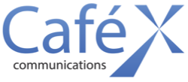
Contributing Factors for Detractors
DETRACTORS
70% consumers abandon shopping cart
56% consumers have to re-explain issue
57%
must switch from web self-serve to voice
59% transferred during support session
62%
must contact repeatedly to resolve issue
Notes:
Abandonment rate: http://baymard.com/lists/cart-abandonment-rate
Other stats: http://www.westmonroepartners.com/en/insights/solution-briefs/customer-effort-scoring

Slide 54



WebRTC+ Can Accelerate eCommerce Growth
Live Assist
Omnichannel
Predictive

Slide 55




Next-Gen Client Experience
Find, connect, and collaborate with
a customer representative
Share screens with customers to run through “what if scenarios” in
real time
Simply touch
a button
Embed collaboration
into existing apps and security

Slide 56
Finance & Banking

Slide 57
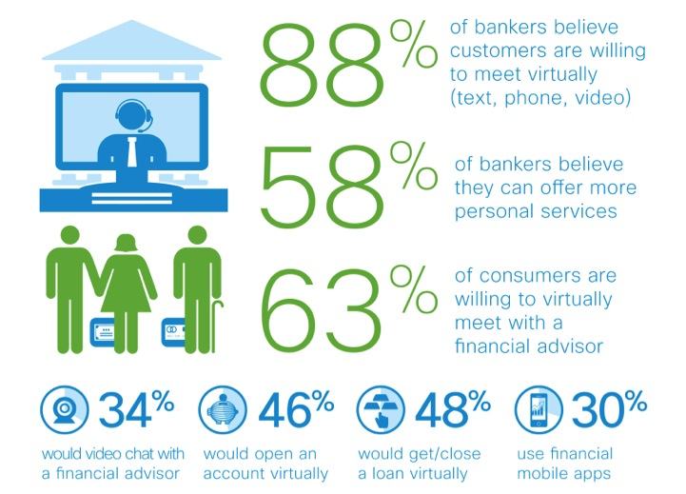
Seamless Access and Personalization

Slide 58
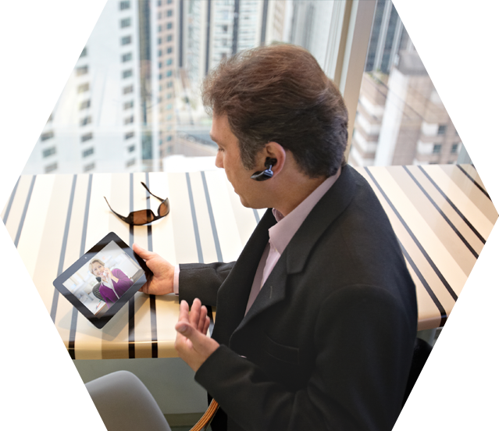
Today’s Changing Environment
Transactions are now virtual, self-service, and impersonal
Personalized customer interaction is where the value exists
In real time - any time
Simple, transparent experience
With access to financial expertise - from any place, especially when mobile
Customers have higher and higher expectations concerning accessibility to information and service in the mobile channels
The customer is the ultimate channel-omnichannel

Slide 59
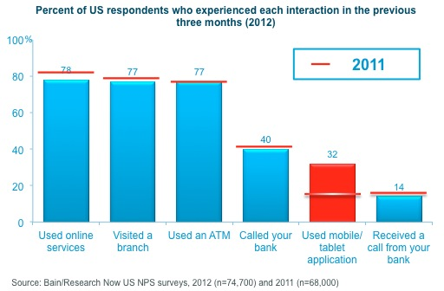

Double-Digit Growth in Mobile Banking
Mobile banking in the US increased sharply from 21% of customers in 2011 to 32% in 2012
“In June 2013, the bank reached a key tipping point, with the number of customers using their smartphone or tablet for mobile banking outnumbering those using traditional Internet banking for the first time.”
Percent of US respondents who experienced each interaction in the previous
three months (2012)
2011
ASB, New Zealand
2013 Annual Report
Source: Bain/Research Now US NPS surveys, 2012 (n=74,700) and 2011 (n=68,000)

Slide 60


The Mobile Channel Is Growing
Asia has the highest mobile banking penetration, while the U.S. has the highest usage frequency.
U.K. 3.7
Germany 1.7
China 1.9
26%
16%
42%
Hong Kong 3.6
41%
South Korea 4.1
Percentage of respondents who had mobile banking interactions in the previous three months
47%
Thailand 1.0
Mexico 2.5
24%
Singapore 1.9
Average number of uses per respondent in previous three months
30%
U.S. 4.9
38%
Australia 3.9
32%
Canada 2.4
27%
India 1.9
From surveys conducted by Bain & Co. in 2012
(150,000 bank customers overall; 74000 in U.S.)
22%
Spain 4.0
France 3.7
37%
34%
26%
Source: Bain & Co. in 2012

Slide 61
Customer Preference Differs by Generation
Device Ownership Differs by Age
Highest ownership and Activity in 18 to 44 age groups
Online Activity Differs by Age
Source: Celent, July 2013

Slide 62
Frequent Mobile Banking Users Give Higher Loyalty Scores Than Other Customers
Percentage point differences in Net Promoter Scores (NPS) between frequent
mobile banking users and non-users
In the U.S., mobile banking users gave their bank a NPS that is 14% higher than customers who do not use mobile banking
Notes: Mobile banking includes use of smartphone/tablet apps and bank websites via smartphone/tablet; frequent users are defined as those in the top quartile for the number of bank interactions using smartphone/tablet apps and bank websites via mobile devices; markets where as 100 for any category were excluded
Sources: Bats/Research Now and Bain/GMI NPS surveys, 2013

Slide 63
The Mobile Channel Is Growing
Asia has the highest mobile banking penetration, while the U.S. has the highest usage frequency.
U.K. 3.7
Germany 1.7
China 1.9
26%
16%
42%
Hong Kong 3.6
41%
South Korea 4.1
Percentage of respondents who had mobile banking interactions in the previous three months
47%
Thailand 1.0
Mexico 2.5
24%
Singapore 1.9
Average number of uses per respondent in previous three months
30%
U.S. 4.9
38%
Australia 3.9
32%
Canada 2.4
27%
India 1.9
From surveys conducted by Bain & Co. in 2012
(150,000 bank customers overall; 74000 in U.S.)
22%
Spain 4.0
France 3.7
37%
34%
26%
Source: Bain & Co. in 2012

Slide 64



Defining Omnichannel
Omnichannel
A customer relationship strategy where the customer is the ultimate center of all interaction channels; decides how, when, and where to communicate with their bank and expects a simple, transparent experience

Slide 65







Enabling the Omnichannel Experience
Customer
Home
Mobile
Branches
Contact Center
Seamless Customer Experience
No Matter Where the Customer and the Advisor are Located
Customer

Slide 66

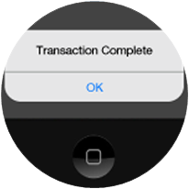


Omnichannel Leads to…
Differentiated Customer Experience
Personalized and interactive
Increase Profit and Revenue
Higher close rate
Increase in up-sell and
cross-sell
Maintain Operating Costs
Common tools and infrastructure
Faster Time to
Serve the Customer
Accelerating to customers’ pace

Slide 67
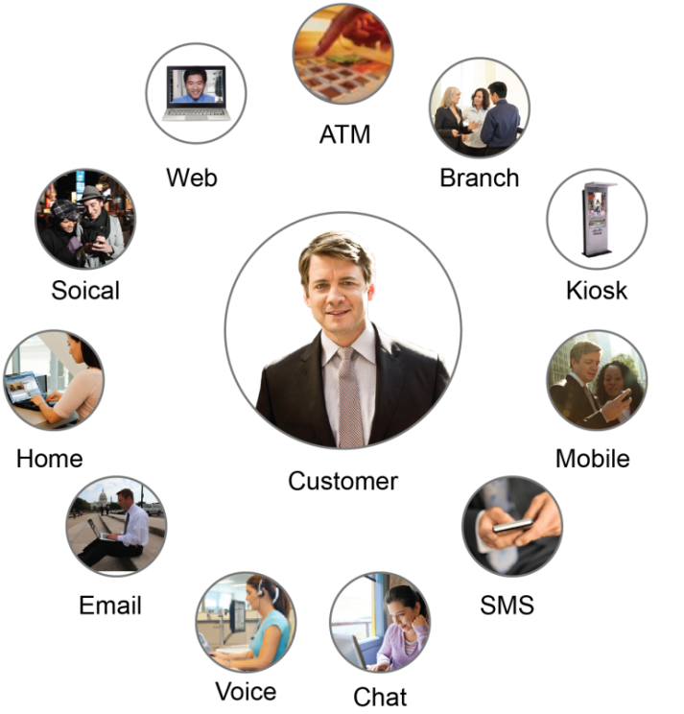

Challenges in the Mobile Channel
Connect
Delivering a simple and personalized customer experience
Transact
Engage
Improving time to serve customer needs, faster than today
Enabling secure collaboration and the ability
to close business

Slide 68

The Voice of Customers – Mobile Channel
What banks are hearing from their customers
“Our customers are asking for video collaboration from our corporate B2C mobile apps.”
“Customers want a visual self-service experience to better optimized their mobile devices.”
“Provide me a differentiated experience.”
“Be device-independent.”
“Fit seamlessly into my mobile and Internet banking environment.”
What banks need to deliver on the omnichannel experience
“Analytics, so I can better understand my customers and improve operations.”
“Deliver a transparent, integrated solution, not a point solution.”

Slide 69



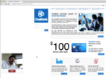








CaféX Fusion
Turning Impersonal Transactions into Personal Interactions
Consumer
Financial Institution
Mobile
Applications
Online Banking
Co-browse and Screen Sharing
Video Call,
Collaboration,
and Transact

Slide 70



Enhance Existing Platforms and Experiences
Insert personalized interaction into
existing banking platforms
Web Portal
Applications
Mobile
Applications
CaféX Fusion video can enable existing platforms and applications, allowing firms to differentiate the client experience in a secure way
CaféX Fusion bridges the internal (employees) and the external (clients) interactions over video by tying consumer video into existing enterprise applications and video infrastructure in a secure way

Slide 71

Secure and Compliant
Application Security
  User data security/protection
    No user data is required for the communication SDK, (no user data transmitted)
    Responsibility is in the customer app and backend services
  Session authentication
    Use of one-time token to ensure request is being made by a valid device
Transport Layer Security (data in flight)
  Data related to CaféX Fusion is secure thru HTTPS, and secure RTP between client and services
Compliance Recording
  CaféX Fusion calls support standard IP-based call recording
Security of backend services
  Application users does not log in or access the backend servers associated with CaféX Fusion
  Administrative access is via user authentication as dictated by enterprise compliance

Slide 72
Healthcare

Slide 73



Tele-Health Addresses Healthcare Challenges
Aging population
Physician shortages
Rural population
Greater demand for services
Increasingly strained supply of services
Large population lacks qualified provider access
Tele-health monitoring market expected to grow from $607M in 2010 to $3.1B by 2017
Sources: Frost & Sullivan, Association of American Medical Colleges, WHO
WinterGreen Research concluded in its new report, "Tele-Health Monitoring: Market Shares, Strategies, and Forecasts, Worldwide, 2011 to 2017.”

Slide 74

Emerging Trends in Healthcare
Rising patient volumes with passage of Affordable Care Act (32MM newly insured)
Aging population with high incidence of chronic disease
Shortage of medical professionals in urban and rural communities by 2020
Escalating costs of care delivery along with significant reductions in reimbursement
New models of care being adopted such as ACOs, Patient Centered Medical Home
The Healthcare systems faces significant challenges that will require greater collaboration and coordination among all stakeholders (administrators, clinicians, payers, and patients)
Notes:
74
Aging populations, a shortage of healthcare practitioners, and rising costs continue to be key challenges in healthcare. Healthcare organizations are increasingly looking to technology innovations and alternate healthcare delivery models to improve patient care while trying to address these challenges.
Findings that support these bullet points:
Rising patient load, especially the elderly and those with chronic diseases
Populations around the world are growing, people are living longer, and, in the U.S., baby boomers are nearing retirement.
The number of baby boomers entering a classifiable disease risk category is increasing by 6% annually. (Frost & Sullivan, 9/08)
More than 90 million Americans live with chronic illnesses (asthma, congestive heart failure, diabetes, hypertension, etc.). The annual medical cost of caring for these patients is more than 75% of total healthcare expenses (U.S. Centers for Disease Control and Prevention).
Shortage of medical professionals
The Journal of the American Medical Association reports a steady decline in the number of US medical student graduates choosing primary care.
In the U.S., the ratio of healthcare staff per citizen is lower than the required amount by more than 40 percent. Staff demands are expected to double over the next 25 years and the crisis is expected to peak between 2010 and 2020. (Frost & Sullivan, 9/08)
Rising cost of providing care
In the U.S., total health spending per person in 2007 was USD 7,439 (Medicare and Medicaid Office).
According to the Organization for Economic Co-operation and Development, healthcare spending in 2007 accounted for:
16% of GDP in the U.S.
10.7% of GDP in Germany
9.7% of GDP in Canada
9.5% of GDP in France
These costs are projected to continue to increase over the next decade.
ERs & EDs are overcrowded and often a patient’s first choice for care
In the U.S., 1 in 3 emergency rooms (ERs) and emergency departments (EDs) are so crowded that ambulances are sometimes diverted to other hospitals. In urban hospitals, the number is 1 in 2. (American Hospital Association)
The uninsured often use ERs/EDs as their primary source of healthcare. Research shows that more insured patients are also using ERs/EDs because it’s inconvenient to see their regular care provider (US Community Tracking Household Study Household survey)
Overuse of ERs/EDs adds cost to an already overburdened healthcare system
Specialists aren’t always available locally
Patients in remote and rural areas often have to travel (sometimes very long distances) to see a doctor or specialist

Slide 75






Video Enabled Patient Care
Merge channel capabilities over time
Digital Channels
Physical
Channels
Put clinicians online via video
Collaboration-enable patient mobile apps and experiences
Educate & advise patients via rich media, social and webinars
Allow patients to schedule visits
“Take the Hospital to the Internet”
Access remote expertise via video
Flexible spaces for private meetings and group seminars
Access to online and digital media
Instantly recognize patients with clinic analytics & mobile check-in
“Bring the Internet to the Hospital”
Notes:
What is our offer – Introducing Fusion – have three solution categories: In-App Communications, Live Assist & Mobile Self Service.

Slide 76





Healthcare Trends
Connect to a Doctor from your iPad / iPhone for $40.00
Notes:
American Well IPad / IPhone to Doctor
http://www.americanwell.com
YouTube video for American Well
http://youtu.be/mO27wtvQRyo
American Well Mobile Support
http://www.americanwell.com/mobileappsupport/

Slide 77
Visual Information Improves Patient Care
Video informed consent improved patient comprehension (78%) compared to verbal informed consent (65%) for knee arthroscopy¹
Video chemotherapy education improved retention of information and management of side effects²
Video improved sunscreen adherence and melanoma knowledge^{3,4}
Video educated heart failure patients had better self adherence⁵
Source:
1 Guttman D, et al. Arthroscopy ,June 2005
2 Kinnare N, et al. European Journal of Cancer Care, July 2008
3 Idriss NZ, et al .Telemed J E-Health, December 2009
4 Loescher LJ, et al. Arch Dermatology, August 2010
5 Albert, NM, et al. Patient Education Council , December 2007

Slide 78
Opportunity: Customers Demand More Convenient Access
Top attributes consumers want from their healthcare provider
Notes:
78
Aging populations, a shortage of healthcare practitioners, and rising costs continue to be key challenges in healthcare. Healthcare organizations are increasingly looking to technology innovations and alternate healthcare delivery models to improve patient care while trying to address these challenges.
Findings that support these bullet points:
Rising patient load, especially the elderly and those with chronic diseases
Populations around the world are growing, people are living longer, and, in the U.S., baby boomers are nearing retirement.
The number of baby boomers entering a classifiable disease risk category is increasing by 6% annually. (Frost & Sullivan, 9/08)
More than 90 million Americans live with chronic illnesses (asthma, congestive heart failure, diabetes, hypertension, etc.). The annual medical cost of caring for these patients is more than 75% of total healthcare expenses (U.S. Centers for Disease Control and Prevention).
Shortage of medical professionals
The Journal of the American Medical Association reports a steady decline in the number of US medical student graduates choosing primary care.
In the U.S., the ratio of healthcare staff per citizen is lower than the required amount by more than 40 percent. Staff demands are expected to double over the next 25 years and the crisis is expected to peak between 2010 and 2020. (Frost & Sullivan, 9/08)
Rising cost of providing care
In the U.S., total health spending per person in 2007 was USD 7,439 (Medicare and Medicaid Office).
According to the Organization for Economic Co-operation and Development, healthcare spending in 2007 accounted for:
16% of GDP in the U.S.
10.7% of GDP in Germany
9.7% of GDP in Canada
9.5% of GDP in France
These costs are projected to continue to increase over the next decade.
ERs & EDs are overcrowded and often a patient’s first choice for care
In the U.S., 1 in 3 emergency rooms (ERs) and emergency departments (EDs) are so crowded that ambulances are sometimes diverted to other hospitals. In urban hospitals, the number is 1 in 2. (American Hospital Association)
The uninsured often use ERs/EDs as their primary source of healthcare. Research shows that more insured patients are also using ERs/EDs because it’s inconvenient to see their regular care provider (US Community Tracking Household Study Household survey)
Overuse of ERs/EDs adds cost to an already overburdened healthcare system
Specialists aren’t always available locally
Patients in remote and rural areas often have to travel (sometimes very long distances) to see a doctor or specialist

Slide 79

Cloud Opportunity
Nearly 90% of all businesses will employ collaboration technology by 2015
CRM
Ent. Social
ERP/HCM
150,000+
Enterprises
($26.5B)
APPS
4.4 Billion
app users
in 2017
142+ BILLION
annual
interactions
2015
1.3 B mobile workers
7.6 M agents
105,179 contact centers
Enterprise
Advocates
25% of all businesses will have a private app store in 2017
Notes:
Smartphones: 680 million smartphones shipped in 2012, we expect to see 1296 smartphones shipped in 2017, almost double the number. Portio Research; http://www.portioresearch.com/
Tablets: 2012 shipments of 136 million, to 2013 shipments of 208 million, going on to 2017 shipments of 398 million devices. Portio Research; http://www.portioresearch.com/
The number of apps users will grow at a CAGR of 29.8 percent, to reach 4.4 billion users by the end of 2017, 4 times as many apps users as there are today. Portio Research; http://www.portioresearch.com/
Mobile subscriber base is forecast to grow at a CAGR of 4.8 percent over the period 2012 to 2017, and annual handset shipments are expected to increase at a CAGR of 6.6 percent over the same time frame, apps downloads are forecast to grow at 35.9 percent CAGR
Gartner: Gartner Forecast: Enterprise Software Markets, Worldwide, 2012-2017, 2Q13 Update
CRM 2014 – $23.8 Billion market (Ex. Salesforce)
ERP / HCM – $27.7 Billion (ex. Workday, Oracle)
Enterprise Social – $3.96B (Ex. Jive Software)
Contact Center Stats: Ovum
7,608,700 total agents (3.1% CAGR)
809,800 hosted agents (18.8% CAGR)
6,798,900 premise based agents (1.8% CAGR) – Ovum
105,179 contact centers world-wide
4,326 contact center with 250+ seats
Mobile Apps
Apple
Google
MSFT
Appcelerator
Adobe PhoneGap
Corona SDK
Cloud CRM
Salesforce
Oracle Sales Cloud
MS Dynamics
ZenDesk
SugarCRM
Premise
Avaya
Cisco
Genesys
Interactive Intelligence
Aspect
Cloud Contact Center
Five9s
inContact
LiveOps
Enghouse Interactive (Cosmocom)
Transera
Genesys (Echopass)
Engagement
Portals
Oracle / RightNow
LivePerson
Egain
Moxie Software
7.6 M agents
& 105K centers world wide
Web
Hubspot
Bootstrap (Twitter)
Salesforce / Heroku1
Webflow
Wordpress

