Slide 1

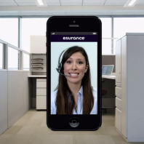








We Enhance Digital Experiences With
Contextual Collaboration
FACT: Mobile & web are
the new face of business
Connect
In-app plugin-less video
Native SDKs
Enterprise integration
By 2015, at least 60% of Internet users will opt for mobile customer service as their first option
Over 90% of users would replace customer channels with a mobile app
SOLUTION
Collaborate
From within app
Co-browse, callback, annotation and more
PROBLEM: When app users need help from a live person
Context
Captured and relayed
Analytics
Customer journey
High friction
experience
(install plugins, switch
channels etc.)
Disconnected
journey
(context lost, re-hash
details, siloes etc.)

