Slide 1
CaféX Case Studies & Use Cases
April 2015

Slide 2

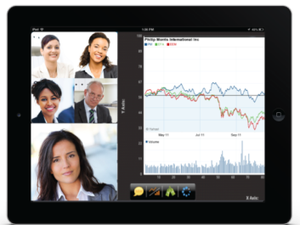
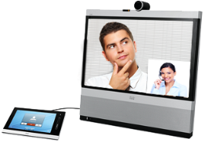
High Net worth Clients & FA: Case Study
Use Case
Enable 3K Financial Advisors & 10K High Net Worth Clients with video collaboration from within bank’s iOS app - no plugins or soft-clients
Client can initiate a chat through presence indicator of FA and launch a video call or join other video calls from within the banking app
Impact
Improve productivity
Speed issue resolution
Foster better partnerships
Collaborate with other expert peers (n-way video); app-share & co-browse
Technology
Mobile Advisor SDK
Cisco VCS/VCE, CUCM and Presence server
FA’s or experts can leverage existing video devices (no rip and replace)
Notes:
Citi Bank

Slide 3


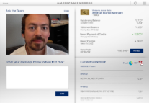

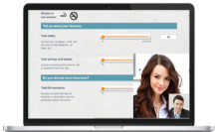
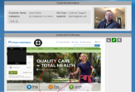

Financial Card Services – Case Study
Enabling initial 45K platinum members with video collaboration with CC Agents through tablet App or MYCA web portal
Card member initiates voice or video call from app
Use Case
Reinforce value of the card
Higher CSAT - 4 pts increase in NPS
Higher conversion rate + upsell
Stronger client-advisor relationships
Agents get more human, personal experience
Impact
Call is routed based on caller status/profile, product to agent/concierge
Fusion Client SDK & Palettes
UCCE Contact Center (CVP,ICM, EX-60, Finesse)
Technology
Account info, online activity “screen popped” to agent / concierge with video call
Notes:
Amex

Slide 4
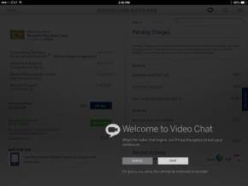
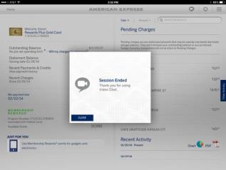
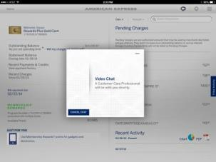
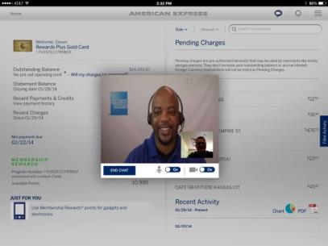
AMEX App – Video Chat
Launch In-App Video
Live Agent Chat
Video Queue
Session End

Slide 5
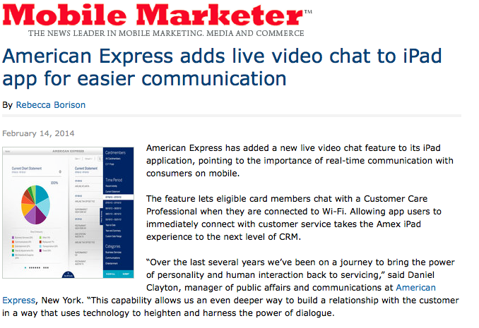
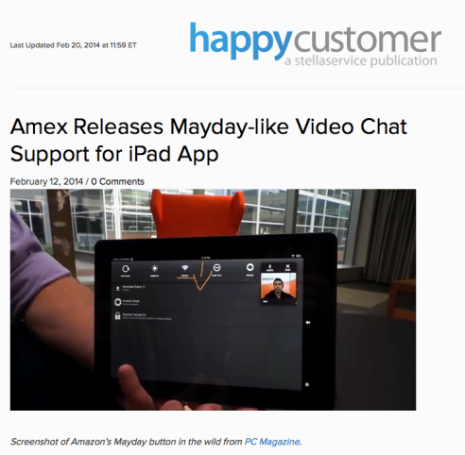
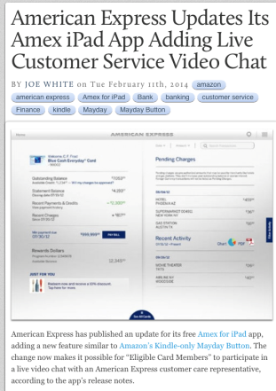
Acknowledging Innovation and Leadership
“Over the last several years we’ve been on a journey to bring the power of personality and human interaction back to servicing,” said Daniel Clayton, manager of public affairs and communications at American Express, New York. “This capability allows us an even deeper way to build a relationship with the customer in a way that uses technology to heighten and harness the power of dialogue.
“Here’s hoping more iOS apps add a similar feature in the near future, because from where we stand making customer service easier to access can only be a good thing.”

Slide 6



Mobile Banking Click for Care – Case Study
Use Case
Customer presses click-for-care button inside app or web page
Enabling a Genesys Contact Center with In-App Click-for-Care Solution
Reinforce value of the card
Upsell opportunity
Higher conversion rate
Foster relationship
Paper off conversion rate
Impact
Call is routed to specific agent in call center based on customer context. Customer is presented with estimated wait time.
CaféX Fusion
UCCE Contact Center (CVP,ICM, EX60, Finesse)
Technology
Account information, web page and other context info are delivered/ “screen popped” to Financial Advisor along with video call
Notes:
Wells Fargo

Slide 7
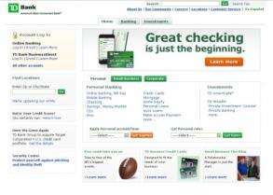
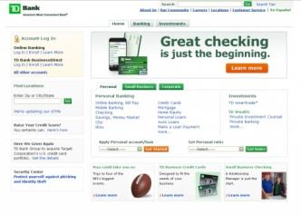
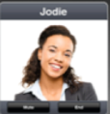

Bank Enables Video Contact Center
Use Case
Customer clicks on link to start video support session
Enable the current bank contact center with video capabilities utilizing Cisco video endpoints and Cisco UCCE
Enable
Add visual IVR into web based access
Video enabled customer engagement
Utilize current CC infrastructure
Video queuing for upsell opportunities
Impact
Call is routed to contact center with video queuing and video IVR. Customer navigates and is routed to video agent.
CaféX Fusion
UCCE Contact Center (CVP,ICM, EX60, Finesse)
Technology
Agent supports customer to resolution of support request
Notes:
TD Bank

Slide 8

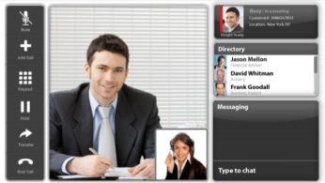
Home Based Agents for Global Tech Giant
Use Case
Customer dials company support through normal mechanisms
Integrated desktop app for home based support agents operating with Genesys and Avaya infrastructure
Lower operational support cost
Unified CRM and communications
Allows for migration to richer support solutions utilizing WebRTC Mac OS apps
Decreases security risk inherent in SIP
Impact
Call is routed to home based agent utilizing the CafeX based MacOS Desktop client with CRM integration
CaféX Fusion
Genesys Contact Center
Avaya CM
Account information and communications solutions integrated for more efficient interaction
Technology
Notes:
Apple

Slide 9
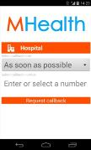
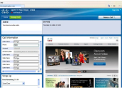
Case Study: Health Insurance with Callback
Use Case
Subscriber requests immediate or scheduled callback from web portal or mobile app
Enabling a Cisco contact center with callback initiated from a web portal or mobile app
Impact
Improves subscriber experience through lower wait times
Increases agent productivity by providing subscriber identity and call context info
A callback is made from an agent catering to the subscriber’s specific needs (claims, coverage, formulary, etc.)
CaféX Fusion Palettes
Palettes Mobile and Web SDK
UCCE Contact Center (CVP, ICM, CUCM)
Technology
Account information, web page and other context info are delivered/ “screen popped” to the call center agent

Slide 10
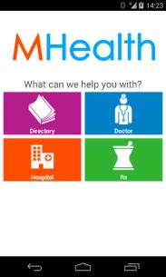

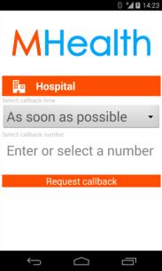
Use Case: Health Insurance with Callback
Patient logs into mobile app and can view options
Patient can click to view more info on topic & request callback
Patient selects an immediate or scheduled callback and provides number

Slide 11


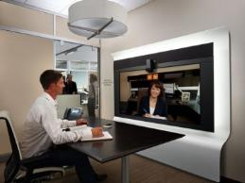
Partner Video with Conference Room Endpoints
Use Case
Company employee sends email to partner or contractor
Initiate ad-hoc video calls with partners via email while utilizing the Cisco enterprise video infrastructure
Impact
Co-browse and document share from web based interface
Maximize existing Cisco infrastructure
Ease of document review and co-browsing
Partner clicks link to start collaboration session to review documents or status
CaféX Fusion
Cisco EX90
Cisco CUCM
Technology
Company employee utilizes enterprise video endpoint in conference room for access
Notes:
Oracle

Slide 12





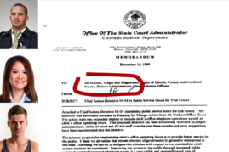


US Justice System & JurisLink – Case Study
Business Impact
Up to $60K/month savings from travel avoidance for attorneys & parole officers
Increased case efficiency
Improved safety
Reuse existing technology
Prisoner meets with attorney via video kiosk
Kiosk
Video chat with attorney
Attorneys don’t need to download an app or client – simply click to collaborate!
Attorney can draw on screen
Attorney can co-browse, push documents & links
Notes:
Use Case: The concept is similar to what we did for private banking….difference is that instead of High Net Worth clients talking to FA, we have Prisoners sitting in a kiosk in the Jail, are video conferenced with an attorney at a scheduled appt time. The Attorney may video/voice conference other Parole officers and can share documents & evidence (e.g. Theft Video etc.) with the parties, co-browse during the session and possibly get a signature on a legal document. This saves the Attorney from physically going to the Jail for appointments.

Slide 13
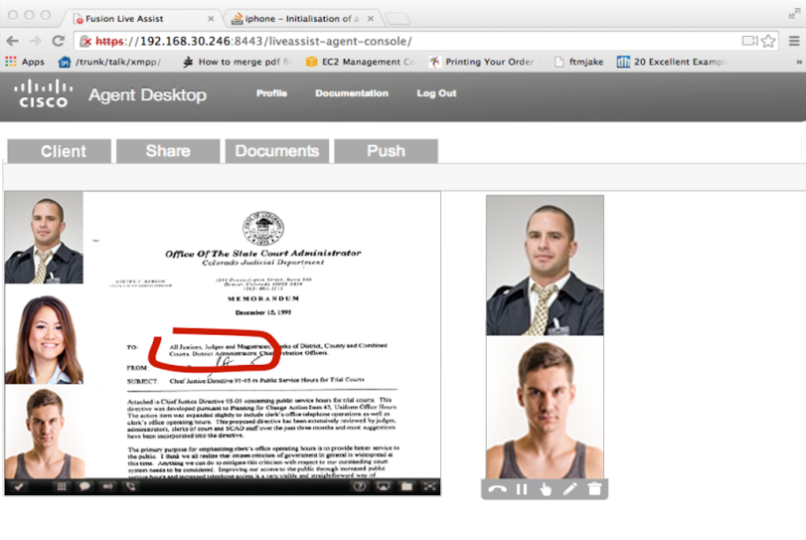



Public Defender Live Assist – Attorney View
Voice or video chat with option to add additional parties
Attorney can view, co-browse & control client’s screen
Share documents & evidence (e.g. video footage)
Highlight text & images
Capture transcript and duration
Session tagging for audit & search
Integration with CC/UC Infrastructure & SIP Endpoints
Notes:
Use Case: The concept is similar to what we did for Citi Pvt banking….difference is that instead of High Net Worth clients talking to FA, we have Prisoners sitting in a kiosk in the Jail, are video conferenced with an attorney at a scheduled appt time. The Attorney may video/voice conference other Parole officers and can share documents & evidence (e.g. Theft Video etc.) with the parties, co-browse during the session and possibly get a signature on a legal document. This saves the Attorney from physically going to the Jail for appointments.

Slide 14
Use Cases

Slide 15
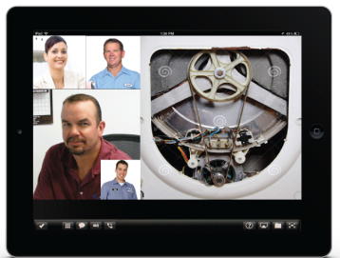




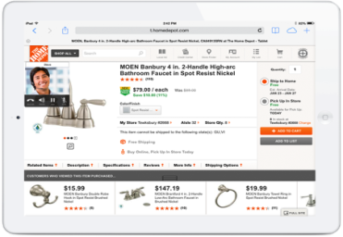
Intra-Enterprise
(mobile employee workforce)
Business-to-Business (B2B)
Field Technicians
Employee Portal
IT Helpdesk
Sales – support staff
Supply Chain
Attorney - Prisoner
Media Relations
USE CASES SPAN BEYOND THE CC
Advisor - Client
Doctor - Patient
Professor - Student
Retail
Citizen Reach
New Client Prospects
B2C Registered/Known Users
B2C Anonymous Users

Slide 16
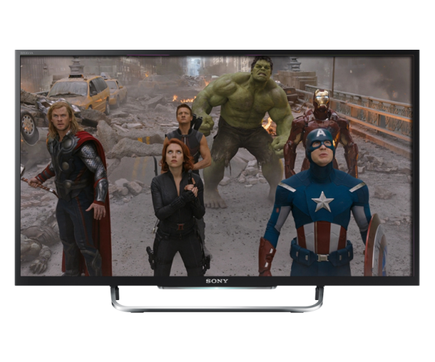

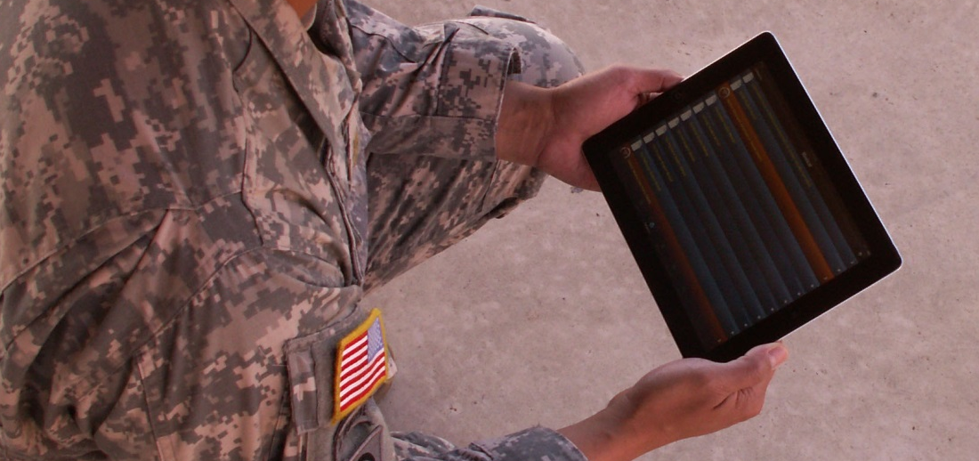
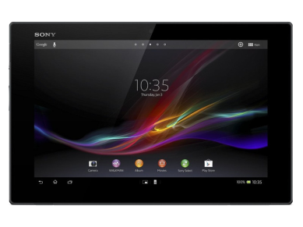
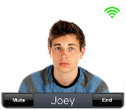
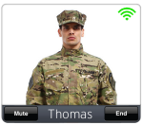

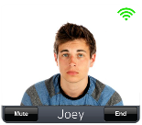



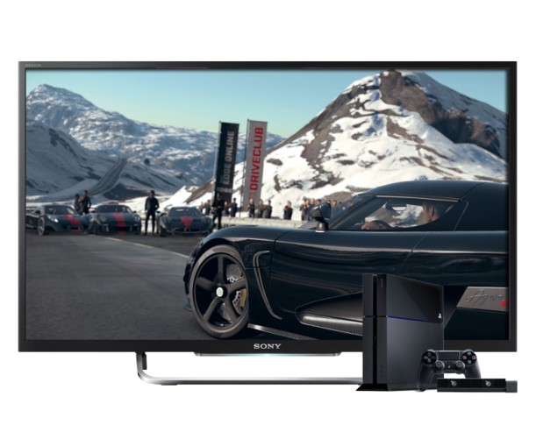
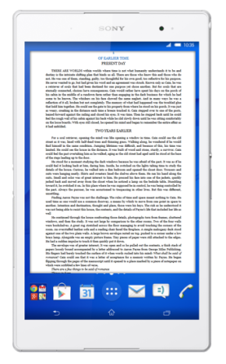

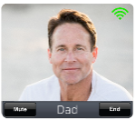


Driving Connected Home Experiences with WebRTC
Dad’s Watching
a Movie on Demand
Thomas is a Soldier on Deployment
Dad Joins Call
Thomas Initiates
a 4 Way Video Call
Mom’s Upstairs Reading on
a Mobile Device
Joey’s Playing Games
on PlayStation
Mom Joins Call
Joey Joins Call

Slide 17
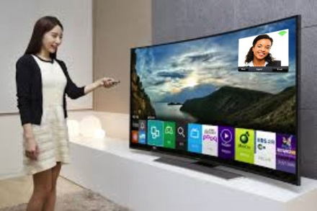

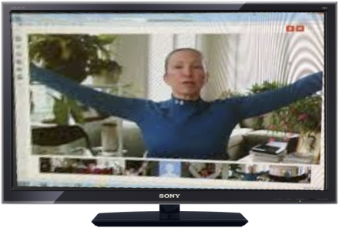

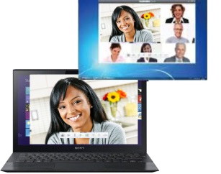
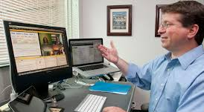
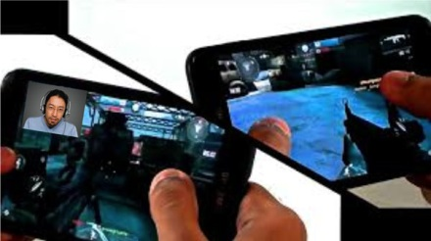
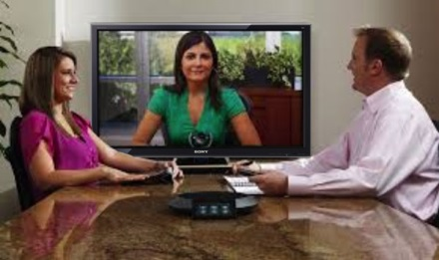
Smart TV
Live Assist
Virtual
Wellness
Creating online
communities with WebRTC voice, video & share
Home Based Video
Collaboration
Online Learning
Virtual Classrooms
Multi-Player
Video Chatting
Tele Presence Endpoint
(Town Hall from Home…)

Slide 18
Use Case Library
Finance
Healthcare
Manufacturing
Higher Education
Insurance
Media & Entertainment
Legal
Retail
Hospitality
Salesforce Integration

Slide 19
Finance

Slide 20
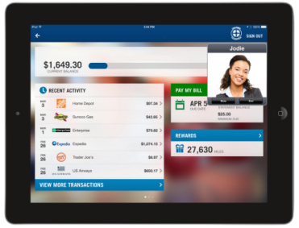
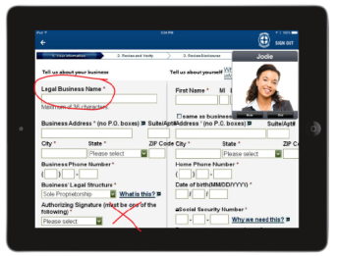
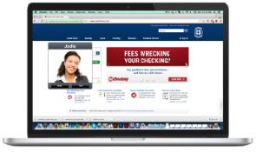
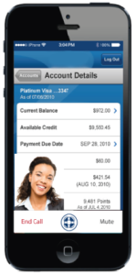

New Account Opening
From Within Mobile & Web App
Problem Resolution
New account form completion with live assist
Goal: Increased conversion
Resolve customer issues w/o tying 1-800 number lines
Goal: Improved FCR & reduced handling time
Use Case #1: Live Assist Enabled Contact Center
Shifting phone customer to self-service web/mobile
Shifting web customer to mobile app
Goal: Increase adoption of digital engagement tools
Educate consumers on app features & answer questions from within the mobile app
Goal: Education & mobile app adoption (decrease cost)
Digital Engagement
Education

Slide 21




Use Case: Visual IVR with Dynamic Representation of Existing VXML
Mobile intercept: user starts in IVR, is prompted to opt in to mobile/web app, is sent a push notification with session continuity from voice to mobile data channel
Visual display of existing Voice XML in mobile/web app using style sheets to match UI & device requirements
Support complex tasks by adding custom UI components within mobile/web app
Dynamic rendering avoids IVR script re-writes, minimizes ongoing admin
Benefits
Increase mobile adoption
Dramatically reduce agent costs via increased call completion within IVR
Reuse existing VXML infrastructure
Reduce 800 charges
Notes:
a visual representation of the palettes visual component description will require an SDK implementation to allow developers to add Fusion Palettes rendering to their applications.
These applications will be responsible for taking the visual component description provided by the Palettes server, combine it with a style sheet (also served from the Palettes Control Server) and render appropriate components for the platform

Slide 22


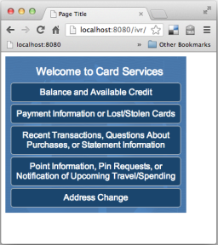
Use Case: Visual Web Self-Service
Palettes JS SDK provides the same mobile feature set as a web application
Replace existing tel: links in web pages with visual representations
Identical backend integration to Mobile VIVR
Co-Browsing support and HTML identification
Coupled with Fusion Client SDK fully featured web based IVR and calling capability
Also used by many customers within native applications where using Web View etc.
HTTP Reverse Proxy
Palettes Server
Fusion
Palettes JS SDK

Slide 23
Use Case: Mobile Intercept
Consumer dials the IVR
IVR prompts the user with an option to use their device instead of voice prompts
On acceptance Palettes pushes a notification to their device.
  Apple Push Notification
  Google Cloud Messaging
  SMS/Email if not registered
Device receives notification and “pops” application on device.
User is now in application at the appropriate place to continue interactions
  Data channel not port on media server
  High accuracy data input
  Continues to interact with call center and call can be continued later.
Increases mobile adoption and helps with detailed self-service transactions

Slide 24


Use Case: Mobile Intercept
3. User opts in to use Visual IVR
1. Call is made into the network via smart phone
Network/Agents
Telephony Server
Interaction Server
2. User provides contextual data via audio IVR
Note: Can be in-memory or DB
Palettes Server
Data Store
Telephony (SIP/GSM)
HTTP (REST and SOAP)
Other

Slide 25




Use Case: Virtual Concierge
Customers request concierge services, tracked by case management system
Objective: extend existing phone service to mobile app
Use natural language processing (NLP) to triage submitted questions
Asynchronous chat engine to pass message between NLP, agents and customers
Ability to up and downgrade from chat to voice call with agent as requested
Virtual Concierge
Type Request Here
Virtual Concierge
Call
Type Request Here
I need some flowers for my wife’s birthday
Where will she be to receive them?
Call
I need flowers for my wife
Will she be there?

Slide 26

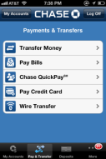

Use Case: Crowdsourced Concierge
Customer starts in web/mobile
Customer posts question via chat
Multiple chat agents and other employees can answer
Fusion Palettes context bus provides singular view to ensure seamless customer experience
Rate answers, reward top contributors
Expert Community 2.0
Question

Slide 27

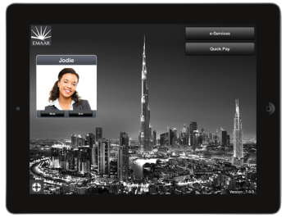
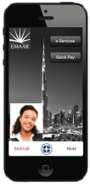
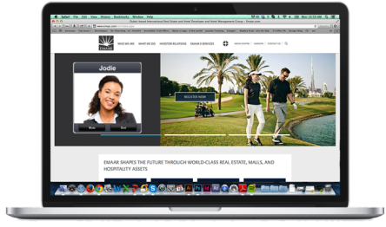
Use Case: WebRTC In-App Communication
Add HD voice & video chat to mobile apps & web pages
WebRTC based (avoid plugins)
Integrates with existing enterprise CC, UC & VoIP assets (SIP)
Frictionless!
Notes:
What is our offer – Introducing Fusion – have three solution categories: In-App Communications, Live Assist & Mobile Self Service.

Slide 28
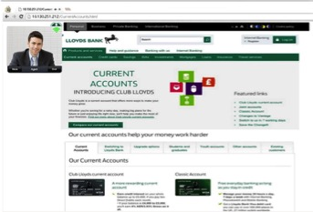


Co-Browse & Live Assist
Client View
Real-time assistance
HD voice & video chat
Customer shares app screen
Expert (advisor) remotely controls
Expert draws on screen
Expert pushes files, links
Form filling by expert
Expert View

Slide 29

Expert Tools for Customer Live Assistance
Customer profile data presented to expert
Pen tool to annotate on customer’s screen
Expert
Expert can click to take remote control of customer’s app screen
Expert has exact view of customer’s app screen
Expert can push pre-set FAQs, docs from CMS & links to videos & surveys
Expert engages in HD voice or video chat with customer

Slide 30



Mortgage – Document Push/Annotation

Slide 31









Caféx Solution - Insert Personalized And Secure Interactions Into Existing Banking Platforms
Consumer
Bank
Common platform across all digital channels
Securely ties client interactions over video into banks existing CC/UC infrastructure
Mobile
Applications
Online Banking
Co-browse , Screen Sharing etc.
Digital Kiosk/In-Branch Virtual Banking
Video,
Collaboration,
Live Assistance & More

Slide 32



Use Case #2: In Branch Experience with a Remote Expert
Create a state of art in-branch experience with video-enabled live assist for customers who walk into the branch:
With specialty group experts (financial advisor or SMB banker)
Draw on expertise located across the country
Expand reach into under-served locations

Slide 33


Use Case #3: Live Assist Enabled Video Teller
Video Enabled ATMs
Providing live assistance at a 24 hour drive up window
Thin branch with no physical tellers
- expand reach into underserved areas
Live assist takes it beyond video:
  Co-browsing
  Document push
  Annotation etc..

Slide 34



New Standard for Retail Banking
Differentiated, Innovative & Customer Centric
Leverage existing infrastructure
Tap into the growing Mobile base
Increase adoption of mobile app by embedding live assistance within it
Differentiate & stay ahead of competition (most banks are moving in this direction)
Available today, proven award-winning solution

Slide 35

Differentiated Client and FA Interaction
Real-time view of market data
WebRTC video embedded seamlessly in banking app
A1 Bank
Shared control & display of portfolio
Session recordings for compliance
Corporate contacts integration
Instant messaging & presence

Slide 36




Car Loan Scenario
Consumer at auto dealership opens bank mobile app to view financing options for new car purchase. Starts live video chat with agent inside mobile app.
Agent knows the consumer is looking at car loans prior to the call, as user’s profile, geo-location, browsing activity are relayed to contact center. Agent pushes a loan application form to the consumer inside mobile app for frictionless transaction.

Slide 37

Use Cases : The Cast……..
Bob : Relationship Manager
Anna: Secondary Relationship Manager
Jeff: Premier Customer
Kim: Jeff’s wife
Sally: Customer Service
Molly: Mortgage Advisor

Slide 38





















    On Demand Video from both public Websites & Online Banking
Jeff starts to go through the ISA options, but he is tight on time.
2
1
3
(ID&V)
Jeff is an existing premier Bank customer, he wants to take advantage of his tax allowance and open up an ISA
Jeff logs in to the Bank account.
Jeff notices the option to select video as a communication channel
Jeff's call is queued in a waiting room and receives video wait treatment on ISA options.
6
4
5
Unfortunately Bob is on vacation this week.
Jeff’s call is routed to a colleague of Bob’s called Anna. The Call is routed by Elite based on skills & preference leveraging Context Store.
(Compliance caveat)
As Jeff is a Bank premier customer he has a relationship manager called Bob.
8
7
9
Jeff is given the option of questionnaire
Anna receives a screen pop giving her all of Jeff’s account information and also that Jeff entered the video channel from web page.
Anna launches the co-browse session and helps Jeff populates information on the application form. Jeff further contributes to the form.
Details are agreed and accepted by Jeff. Transaction is recorded.

Slide 39

















    On Demand Video from within Mobile Banking Application
Jeff wants to explore this offer for his joint account that he has with his wife Kim.
1
2
3
Jeff, while having a cup of coffee at his favourite coffee shop, checks his account balance from his Bank app.
Jeff sees from this Bank account that there is a special loan offer for Bank premier customers.
Jeff hits the chat button.
LOAN??
4
Bob suggests that the chat session is escalated to video to continue with the app process.
6
5
As Jeff is a Bank premier customer, he has a RM called Bob. Chat session is routed via CC with Jeff ’s context.
Screen pop gives Bob all of Jeff’s account information and that Jeff entered the chat session from the ISA web page.
8
7
9
The details are agreed and accepted by both Jeff and Kim. Transaction & events recorded. A copy of the doc is emailed.
Both are given option of questionnaire.
As the loan will in a joint account with Kim, Bob initiates a 3-way video session to go through all the details with Jeff & Kim together.
Bob generates a specific loan offer for Jeff and shares this document with Jeff.
Notes:
Bob: relationship manager
Kim: wife

Slide 40











    Colleague-led Video Conversations Offered to Customers As Required
1
2
3
Bob uses the Bank booking system to schedule an appointment with Jeff.
Jeff receives an invite via email from Bob, he can’t make the appointment and instead proposes to Bob an alternative date/time.
Bob as a Relationship Manager has regular appointments with his key clients.
Jeff calls in a little early and is queued in a waiting room with video wait treatment.
5
4
6
Jeff clicks on the ‘click here’ button in the meeting invite from Bob.
Jeff, receives a reminder a few minutes prior to scheduled appointment.
Jeff accepts the sent alternative meeting invite.
(& Compliance information)
8
9
7
Jeff given option of questionnaire.
Bob completes his current call and accepts the incoming video session from Jeff. Bob receives a screen pop of all Jeff’s account history.
Bob receives a notification that Jeff is waiting. (Bob is given the option to ‘pass’ Jeff onto another colleague)
Bob can offer to share his screen so Jeff can see the specific information Bob is referring to.
Notes:
Redirect to another colleague.
Share screen: account details

Slide 41















    On-Demand Video from a Kiosk Style Environment at a Branch
1
2
3
Sally invites Jeff to co-browsing session.
While logged into his account, Jeff sees attractive mortgage offers, he decides to call customer service to enquire further.
Sally receives call & context notification that Jeff had run the mortgage calculator.
Sally takes Jeff through some Mortgage options.
6
5
4
Wait treatment is shown on specific selection by Jeff. And Compliance information.
Jeff’s train is late and misses the scheduled appointed .
Sally – arranges for an appointment with a mortgage advisor. At his local branch.
The concierge checks the availability of the mortgage team, verifies Jeff’s passport and then sets the video kiosk up for Jeff.
8
9
Snap shot of acceptance and recorded as part of the transcript .
Jeff – is connected on video to Molly a Mortgage advisor.
Screen pop precedes video.
Molly shares mortgage documents and T&Cs for Jeff to see & contribute.
Later that week, Jeff and his wife Kim are reviewing the offer of their iPad and contact Molly to answer other questions.
Notes:
Shared with Jeff mortgage details.

Slide 42






Expand Sales and Advice Reach to the Home and Mobility
Business Challenges
Business Capability Enabled
Business Outcome
Impersonal experience keeps customers at a distance
Fusion (Internet or Fusion device) experience is limited to simple transactions or limited experience, for example, “click to call me on the phone”
Ability to reach mortgage banker from home, browser, or Fusion device
Banker enabled to screen-share information and collaborate virtually
Ability to schedule follow-up
Increased wallet share
Increased customer satisfaction and increased revenue
Bank expands reach of mortgage loan specialists while ensuring quality
Business Scenario
Customer at home needs is considering prequalification for a new mortgage. While browsing the bank’s website, she has a few questions she’d like to ask the bank. She clicks on “video call with advisor” on the bank’s website.
Client likes initial conversation and agrees to move forward. Schedules an evening meeting with the advisor when her spouse comes home. Client receives message on her smartphone confirming the meeting.
Customer and mortgage officer meet a the reserved time over video on their home tablet or PC. The loan officer shares his screen and shows the customer the differences between a 20 and 30 year mortgage. Client moves forward with mortgage application.
Request is routed to an available mortgage banking advisor, who picks up call and has a video meeting with the customer.

Slide 43




Differentiate Wealth Management Services
Business Challenges
Business Capability Enabled
Business Outcome
Serving high net-worth and mass-affluent customers with personalized service
Enable customers to obtain advice from various sources when markets move
Improve efficacy of wealth managers and personal financial managers (PFMs)
Presence available to customers
Ability to escalate from IM chat to video
Share information through screen sharing
Record based on policy triggers
Improve productivity of wealth managers and PFMs
Speed issue resolution
Foster better partnerships between private bankers and financial advisors and their clients.
Business Scenario
Customer is getting nervous about investment allocations due to recent movement in the market.
Private banker then has an expert in international markets join the video meeting with customer from his Fusion phone. The expert offers insights and data to customer.
Customer logs into secure application or portal on her iPad to see the impact on her portfolio. Seeing that the private banker is available, she sends an instant message requesting a meeting.
The customer then invites her tax attorney and accountant to join the meeting from her tablet to
get insights on the tax implications.
Private banker invites customer to escalate to a video meeting from her iPad and customer joins the meeting via a button on her banking application screen.
The customer makes a decision on how to proceed. Audio track of the interaction is recorded, based on policy triggers.

Slide 44



Concierge Services for Card Holders
Business Challenges
Business Capability Enabled
Business Outcome
Increase card member retention and new acquisitions
Providing tiered services to recognize and reward customer loyalty
Delivering a differentiated service
Access to expertise enabled by customer services and membership tier
Advisor able to see customer relationship information
Advisor able to close transaction and cross sell
Reinforce value of the card and customer loyalty
Enable higher conversion rate
Foster relationship with dedicated travel counselor
Move to “Digital wallet” and eliminate paper
Business Scenario
Customer is considering some international travel and reaches out to credit card provider for assistance.
Call arrives with customer information through a “screen pop” on the agent’s desktop; a two-way video session is initiated.
Call is routed based on caller status/profile, product, and other attributes to the appropriate agent with travel expertise.
Customer makes decision to book the travel. Agent assists, showing the itineraries, and as booking takes place, the agent cross-sells additional services, such as insurance and all charges go on the customer’s card.

Slide 45





Streamline to Delight Customers
Business Challenges
Business Capability Enabled
Business Outcome
Customers frustrated by being asked to repeat information
Moving from Fusion banking to contacting the bank requires too many steps
Need to preserve years of investment in voice self-service routing scripts
Fusion screen and menu choices are mapped to self-service menus
Customer request is routed to a mortgage lending advisor equipped with video and screen sharing
Customer can sign a document via a touch screen device such as a tablet
Increased customer conversion rate to Fusion channel
Optimized agent utilization
Improved customer convenience via visual menuing
Increase existing investments
Business Scenario
Customer is looking at mortgage refinance options and has arrived at a point where he wants to talk with a mortgage specialist.
Account information, web page, and other context information are delivered (“screen popped”) by Fusion along with the video call to a mortgage loan officer.
Call is “self-served” through visual menu and request is routed based on caller status, profile, product, and other attributes to appropriate mortgage loan officer.
When loan officers accepts the call, an audio, video and collaboration link is established with the customer. The loan officer notifies customer of new refinance rates and offers customer to lock in at this current rate. Customer agrees and signs the lock-in document through his tablet.

Slide 46




Next-Gen Client Experience
Find, connect, and collaborate with
a customer representative
Share screens with customers to run through “what if scenarios” in
real time
Simply touch
a button
Embed collaboration
into existing apps and security

Slide 47



















CaféX Fusion Architecture
Mobile Experience
Public
Internet
Firewall Traversal, Signaling, and Media
CaféX Fusion Web Gateway
CaféX Fusion Media Broker
Infrastructure
CVP
MCU
CUCM
Contact Center
VXML GW
MediaSense
CUBE
TMS
App Server
Advisor

Slide 48

CaféX Fusion Capabilities
Integrates video - and the ability to find, connect, and collaborate with an advisor - with your existing mobile applications, so your customers can initiate personal interactions at the touch of a button
Delivers a complete omnichannel experience when integrated with other solutions so your customers can easily move from mobile to branch channels as needed, to complete a complex financial transaction
Embed video calls and interactions into your existing mobile and Internet banking applications
Zero download required on customer side
Lets customers smoothly escalate their interaction with your advisors from an instant-message chat session to an audio or video call, within a single application session

Slide 49

CaféX Fusion Capabilities
Ability to share screen with customer to run through “what if’” scenarios; for example, show difference in monthly payments between 20- and 30-year mortgages or test a portfolio in real time
Create visual IVR in mobile app to eliminate having the customer provide the information multiple times
Supports voice, video, presence, web, file sharing, as well as mobile and business-to-any (B2X) collaboration applications
Equips your advisors in areas such as wealth management to meet in customers’ homes or offices and quickly bring in another specialist

Slide 50

Why Choose CaféX for Retail Banking
An omnichannel enabler, CaféX Fusion is scalable and integrated
As an enterprise-class comprehensive system to support mission-critical operations
Accounting for quality, performance, experience in a secure manner
Integration and services helps ensure that positive business outcomes are realized more quickly and with less expense and risk
Takes advantage of existing investments that support performance, security, and agility
Delivers business-critical communications with bank customers
Cisco is unique in that our core competency is as an enabler of business-critical communications in real time,
across multiple channels

Slide 51
Other Financial Use Cases
# | Name | Use Cases | Technologies | Priority | Level of Effort | Cisco Solution
1 | Sticky Agent | Know my last call information and if this call is a repeat (similar contextual information), make an attempt to connect to previous agent. (precision routing to help build attributes to get right advisor to right agent) | CDR/CRM (what CRM will we tie into?) integration, Queue to Agent | H | M | Queue to Agent (looks up who caller spoke to last time and queue to them) – need to undertand with customer exceptions (what if agent on vacation)
2 | Anticipate Action | Understand what I want to / need to do next in my transaction or workflow and make recommendations. | Predictive analytics | H | M | OmniChannel Analytics, Precision Routing – what databases?
3 | IVR Bypass | Connect to contact center and pass contextual data thru any device chosen by advisor (Cell, Tablet, Desktop), and thru any channel (Web, Chat, Voice, etc..) | Multi-Channel | M | L | Mobile Advisor Palettes
4 | Escalate Channels / Context Carryover | Ensure all channels of communications are synchronized (Web interaction, chat, call), ability to escalate from one to the other without losing contextual data about the contact or the account they are working on. Pass all contextual information to agent desktop regardless of channel used. | Multi-Channel | M | M | eGain / Mobile Advisor Palettes/ CEBT
5 | Same as 3 | Ability to get assistance from a knowledge worker based on where they are at in their online workflow (Click a “help” button ala Amazon) | Multi-Channel, Mobility | M | L | Mobile Advisor SDK / Cisco UC via Branch Project
6 | Remote Expert | Face to face communications as an option for interaction with a rep. based my preferences | Video | L | M | Remote Expert or Unified Communications
7 | Visual IVR from web / Courtesy Callback | Ability to select a callback if queue is too high. Have outbound call placed to advisor selected phone number when an agent is ready. Option to chose callback available thru voice channel or on web | Callback | M | L | Mobile Advisor Visual IVR
8 | Advisor Segmentation | Provide preferential treatment based on advisor (or advisor office) based on value to AFI and preferences. (need to scope, what are their business rules and desires) | Precision Routing | M | M | Precision Routing
9 | Same as 3, 5 | Ability to view queue wait times (by chosen queue) online. | Multi-Channel | M |  | Visual IVR
Notes:
Level one = paragraph text
Hit increase level for first bullet level
Hit increase indent for second bullet level
Hit increase indent for third bullet level

Slide 52
Other Financial Use Cases
# | Name | Use Cases | Technologies | Priority | Level of Effort | Cisco Solution | Cost
10 | Same as 4 | Ability to quickly convert an interaction (call, chat, etc..) into a desktop sharing (agent connects to advisor desktop) | Multi-Channel, Desktop Sharing | L | L | eGain / MA or Webex
11 | Out of scope, Ameriprise already looking at solution | Ability to collect business data and analyze for fraudulent activity.
12 | Call Intent (same as 1, 2,3) | Calling into IVR is complicated by complex products and need to authenticate users (who they are and who they are calling on behalf of) – Leads to misrouting often and low satisfaction (45% in 2011) – Need to simplify experience by understanding what the advisor is calling about thus making routing easier | Analytics / Context | L | M | (query DB’s and ask are you calling about…?)
13 | Outbound Snowball | Ability to analyze calling patterns to determine trends or additional assistance needed – thus driving a proactive outbound call | Predictive analytics | H |  | OmniChannel Analytics
14 | Not possible, (maybe present options) | Know why a caller called via analytics, and automate the wrap-up so agents can quickly get back in queue and reporting can automatically categorize the call | Analytics | L | M
15 |  | 360 View of the caller and single business record of the complete interaction, from the call logs, to the recording of the call, to the case or CRM info associated with the call, etc. | Data Virtualization | L | M | Exony / Composite
Notes:
Level one = paragraph text
Hit increase level for first bullet level
Hit increase indent for second bullet level
Hit increase indent for third bullet level

Slide 53
Healthcare

Slide 54








Remote Doctor’s Rounds
Emergency Consult with Specialist
IN-ROOM CARE
USE CASES
Nurse Video Call Button
Patient-Family Collaboration Portal

Slide 55



Enhanced In-Room Care Benefits
Enhanced Patient Satisfaction
Improved Clinician Productivity
  Faster access to personalized care
  Maintain connections to family & friends
Time and mobility efficiencies
Broader access to specialist expertise
Higher Inpatient Bed Occupancy Rate
Reuse of Existing Systems
WebRTC-based extension of existing in-room platforms and applications
  Increased hospital revenues
  Improved bed utilization

Slide 56

Video-Enabled Healthcare.gov
Video-enabled “Live Assist” to ease on-boarding and enrollment of new members
Real-time face-to-face video chat built into web portal with no download or plugin

Slide 57

Mobile Self-Service for Patient Care
Render existing IVR menus, prompts visually within existing patient-facing mobile apps
Enhance self-service to improve patient experience & clinician efficiency

Slide 58






Click to Call From Patient Portal
Large US medical group, specializing in post-hospital discharge care, uses click-to-video & video conferencing between patient, clinicians & family members – all from browser portal with no plugins or downloads
PSTN
HTTPS
SIP
JavaScript /
Client SDK
CaféX Fusion
Existing UC
Infrastructure
POTS or
Mobile

Slide 59








Click to Video from Patient Portal
PSTN
HTTPS
SIP
Internet
HTTPS
PatienceName
JavaScript /
Client SDK
CaféX Fusion
Existing UC
Infrastructure
********
Patient
Portal

Slide 60




Telemedicine: Remote Video Enabled Consults
Challenge Large US Hospital wants to expand reach to remote, under-served areas Solution Leverage Fusion Live Assist for video-enabled remote care over the internet
Patient logs on to hospital’s portal
(web-browser or tablet)
Greeted by video concierge (waiting room)
Clinician consult
(uses existing video device, tablet or browser)
Clinician conferences in other specialist to 3-way conference
Secure authentication. No headache of downloads or setup for patients
Reuse existing video devices
Share X-rays, medical records securely

Slide 61





Personalized, Contextual Engagement
Expert View
End User View
In-App HD Audio/Video
Mobile & Web
Co-Browse
Remotely Control App
Push Docs & Links
Photo Share
Draw On Screen Highlight & Annotate
Capture Context Across Web, Chat, Video
CaféX Communications Confidential © 2014 – All Rights Reserved.
61

Slide 62


Differentiated Patient & Clinician Interaction
Real-time view of patient data
WebRTC video embedded seamlessly in healthcare app
Shared control & display of patient records
Multi-modal recordings for compliance
Corporate contacts integration
Instant messaging & presence

Slide 63




Patient – Clinician – Specialist iOS App
CUCM Voice
Help Page
Visual Voicemail
Video with Full Screen Option
Instant Messaging
Dial Pad with Short Number Dialing
File Sharing & Streaming
Integrated Jabber Presence
Full Screen
Contacts from Directory, Address Book
N-Way Voice/Video Calling

Slide 64

Sample iPad App
Control of Video Carts from a IPad
  Pan
  Tilt
  Zoom
HTML 5 Whiteboard
Interactive on any
device
  Cisco Tandberg
  Browser
  Tablet
  Mobile Phone
Co Browse
Annotation

Slide 65




CaféX Live Assist
(Video Enabled Remote Expert)
Web or mobile app-based
One-way or two-way video in floating window
HD video (720p) & audio (Opus)
Full screen video zoom (vs. small window)
Instant messaging
App-side: mute audio and/or video
App-side: photo-snapshot & share with expert
Expert-side document sharing
  Remote control: scroll / pan / zoom & click
  PDF, Images, URLs
  Palettes applications (e.g. visual IVR)
Two line integration for both mobile & web!
More robust annotation:
  Highlighter (transparency) + Pen
  Shapes, Text, Different Colors
  Annotation over live video

Slide 66




CVS Pharmacy with Mobile Advisor
Provide A Personal Customer Experience
Web or mobile app-based
HD video (up to 720p)
One-way or two-way video in floating window
Full screen video
Document sharing with customer
Prescriptions instructions
How many pills per day
Not to take with out food
Annotation:
Highlighter (transparency) + Pen
Shapes
Text
Different Colors
Annotation over live video
Digital Signature
Transactions need physical documents/wet signatures

Slide 67
Manufacturing

Slide 68








Connected Factory Shop Floor – Use Case
Use Case
Enable staff and supervisors with video collaboration and other “live assist” functions from within iOS app to reduce downtime & quality issues on shop floor
Shop floor / assembly line has an issue – downtime or quality impact!
Increase manufacturing efficiency (throughput, capacity utilization)
Increase yield, reduce rejects
On-time delivery, shorter cycle times
Impact
Worker launches video chat within company iPad app to supervisor who loops in remote expert on EX-60
Technology
CaféX Fusion Client SDK
Cisco VCS/VCE, MCU, TMS, CUCM & EX-60/90
Supplier is pulled into the conference & part diagram is shown on the screen with annotation, co-browsing so that supplier can send the exact part

Slide 69


Field Technician Tablet App
CUCM Voice
Help Page
Visual Voicemail
Video with Full Screen Option
Instant Messaging
Dial Pad with Short Number Dialing
File Sharing & Streaming
Integrated Jabber Presence
Full Screen
Contacts from Directory, Address Book
N-Way Voice/Video Calling

Slide 70






Push to Talk for Remote Support Services
Challenges
Scenario
Public sector firms need fast, seamless communication to support field staff without costly plans or private radio systems
Need to provide differentiated support
3
Instant visual context allows expert to identify issue and advise technician, leading to rapid resolution of service request.
1
Field technician is on a job site and requires assistance from an engineer to troubleshoot a service request.
Outcome
Technician’s iPad
Expert’s Enterprise Cisco Endpoint
Save time with instant video chat & auto-answer
Faster decision-making within business process
Improved service levels and field productivity
internet
2
Technician uses video-enabled Push-to-Talk iPad app with Auto-Answer
Presence-enabled contacts
Click-to-video with auto-answer
70

Slide 71

Oil/Gas Rig Cameras Linked to Web Portal
Security cameras on oil rigs
Customer ask: Link oil rig cameras into web portal and to enterprise network (specifically teleconference)
Server application generates SDP and sets up media channels into the enterprise via the Fusion Media Broker
Technologies:
  Fusion Client SDK
  Fusion Web Gateway
  Fusion Media Broker
  Cisco VCS-C and VCS-E
  Cisco MCU
71

Slide 72
Higher Education

Slide 73







Elevated Student Experience for Financial Aid
CaféX USER EXPERIENCE
Student engages
school’s financial aid department via mobile app
IVR displayed visually & dynamically
Fills in complex form
but no agent needed
Switches to tablet and has question - seamless
click-to-video
Capture student context for
smart routing & analytics
Aid specialist resolves issue rapidly
Accelerate resolution & attract prospective Gen-Y students

Slide 74




Real-Time Student Engagement
Screen Share & Remote Control
Agent helps student navigate website / app
Shared control, no ball passing
Click-to-Video
No browser plugin
Floating window
Enterprise integration
Annotation
Agent draws on site, displayed on student’s screen

Slide 75






Contextual Student Engagement
Push Documents & Links to Student
Push Other Content & Capture Context
Videos
Visual IVR
Web applications
Capture student’s online context & relay to agent

Slide 76


Student – TA – Professor Collaboration
CUCM Voice
Help Page
Visual Voicemail
Video with Full Screen Option
Instant Messaging
Dial Pad with Short Number Dialing
File Sharing & Streaming
Integrated Jabber Presence
Full Screen
Contacts from Directory, Address Book
N-Way Voice/Video Calling

Slide 77







Enhance Student / Supervisor Interactions
Challenges
Scenario
Student has an appointment with teaching supervisor for a 1:1 meeting, currently has to travel from dormitory or from off-site to campus.
1
2
At the appropriate time the student receives a reminder to join the meeting. A simple URL is presented which opens the browser and immediately rings the supervisors endpoint (Cisco 9971 / EX90 / Jabber /Lync/Web-RTC). No plug-ins installed on student computer.
Student logs onto portal and books an appointment with teaching supervisor. Calendar and presence (Lync/Jabber) exposed for either immediate or scheduled appointment
1:1 session is established and student and tutor have full voice, video and collaboration through standard Internet browser
Internet/Campus
3
Outcome
Personalized interaction using video, easy setup, less no-shows
Leverage current investments in network infrastructure and video endpoints
Notes:
What is our offer – Introducing Fusion – have three solution categories: In-App Communications, Live Assist & Mobile Self Service.

Slide 78




Push to Talk/Video for Campus Security
Challenges
Scenario
Colleges/universities campuses need instant communication between students & campus security without costly radio systems
Need to provide differentiated support
3
Instant visual context allows security to identify issue and advise student, leading to rapid response and resolution.
1
Students on campus encounter a safety issue and need to reach campus security ASAP.
Outcome
Student’s iPhone with School App
Campus Security Cisco Endpoint
Enhanced student safety
Rapid response with video chat & auto-answer
Avoid cost of dedicated terminals
Reuse UC infrastructure
internet
2
Student uses school’s video-enabled Push-to-Talk iPhone app with Auto-Answer
Presence-enabled contacts
Click-to-video with auto-answer

Slide 79
Insurance

Slide 80





Insurance Agent & Client Virtual Engagement
Existing client has ‘life event’. Agent sends invite for virtual meeting to review needs
Client clicks on link to connect to agent – no plugins or downloads!
Agent & client engage via video, co-browse, file share & annotation
Agent brings in expert to explain taxation of cash value withdrawals for new policy
Client completes life insurance application virtually with wet signature
Agent sets stage for underwriting process & schedules lab work
Accelerate Time To Revenue & Improve Client Satisfaction
Notes:
Insurance Industry Use Cases
Created by Rob Cornwell, Senior Advisor for Insurance, Cisco Systems
Agent & Existing Client Virtual Interaction
Agent has existing insurance policies in place with client (could be Auto, Home or existing Life policy) Agent learns that the client has had a “life event” (birth of a child) and wants to schedule an appointment with the client to review their needs.
Agent sends e-mail invite with a link or “connect now” “easy button” for a “Virtual Client Review” appointment
Client receives the invite and uses tablet to click on the link which leads to the company web-site and provides “connect now” options with options to chat, call or video interact with the agent ( client chooses video)
Agent greets client who is at home with spouse and provides context for review appointment…
Agent share s desktop and briefly runs through existing policy coverage for client’s account…
Agent pivots to/asks about life insurance (couple just had baby)
Client agrees this is something they should probably review
Agent co-browses with client on company website to review resources such as a Life Insurance Needs calculator to determine how much coverage the client will need and various life insurance product links to show different coverage options…
Agent completes a Life Insurance Needs calculator with client from the web-site (agent can complete and share desktop or walk client through completion/co-browse/annotate…)
Agent reviews a life insurance illustration that the client agrees may meet their needs. The illustration shows cash value building in the policy over time.
Client has questions regarding taxation of cash value withdrawals to be used to pay for college costs down the road
Agent IM’s SME from home office to bring them into conversation
Agent brings in a remote expert from home office escalating from chat to video interaction with the client.
SME/remote expert answers client and agent questions about taxable consequences in using policy cash values to supplement college funding for child in future…
Agent and client are satisfied and decide to move forward with the application process…
Client shows spouse the illustration off his tablet as she has been attending to the baby while he’s been interacting with the agent
Agent greets spouse, is glad to see her and baby are doing well…
Agent completes application with client virtually
Client signs application via wet ink
Agent set’s stage for underwriting process, schedules lab work to be gathered from client with a 3rd party source by clicking to check appointment time availability, IM, call or video…

Slide 81









Virtual Insurance Protection Review
Existing client has ‘life event’. Agent sends invite for virtual meeting to review needs
Client clicks on link to connect to agent at time of scheduled appointment. One or Two Way video is OPTIONAL.
Agent & client engage via video, co-browse, file share & annotation
Agent reviews life insurance plan options with customer
and serves as “Trusted Advisor” in planning process
Client completes life insurance application virtually with e-signature
Agent sets stage for underwriting process & schedules lab work
Accelerate Time To Revenue & Improve Client Satisfaction

Slide 82







Video Enhanced Quote Proposal
Prospective client has provided Agent with information needed for an insurance quote
Agent sends prospect link for “click to connect” to virtual meeting to review the quote proposal
Agent goes through quote proposal with prospect to point out value propositions
Agent assists customer with e-signature process. Enhance personal connection as “trusted advisor”
Agent & client engage via video, co-browse, file share & annotation
Accelerate Time To Revenue & Improve Client Satisfaction

Slide 83













Warm Transfer of Prospect from Web Channel
Prospect is shopping for insurance
on web and “clicks to connect” for
assistance
CSR receives request for assistance from web
Prospective client shopping for insurance online clicks on “Quick Quote” option
Client needs help to complete quote so clicks on “Live Assist”
Service rep working from home is connected to client via text & video chat. Can see client’s browsing context, co-browse, annotate, share files
Click Here For Video Assistance
CSR or Agent View
Client View
Client gets real-time help to complete quote and decides to move ahead with a formal application. Client is onboarded with online account login, pocket mobile app, “Customer Rewards” link
File Share
Co-Browse
Annotate
CSR provides virtual assistance
Decreased web interaction abandonment
Higher new client close rate
Up/cross-sell of services
Increased CSR efficiency
“Wow factor” client experience!
Co-browse & screen share
Annotate & file share
Floating video window
One Way or Two Way Video OPTIONAL!

Slide 84
Key Capabilities Demonstrated
Real-time Virtual Interaction for Customers & Agents
“Click To Connect” – can be embedded in existing applications, no customer downloads
Unified Call Control- Voice and Video from the same or different devices
Share content between devices, co-browse, navigate, annotate…
Any device, any time, any where
Rich media sharing
Secure internal and external communications

Slide 85







Accelerated Auto Claims Process
Challenge
Use Case Scenario
Policyholder involved in auto accident needs real-time assistance from insurer & other parties
Live video chat with agent who can see customer’s geo-location & account info
Agent pushes relevant documents & web links to customer
Customer following accident opens insurance firm’s mobile app, taps “Live Assist” to connect to agent
Agent conferences in other parties via voice/video
roadside assistance
body shop
car rental agency
Business Impact
Seamless “Live Assist” experience for policyholder
Increased client loyalty, makes personal referrals
Accelerated claims processing
Customer amazed by all-in-one claims process
Customer shares video & photos of crash site with agent in real-time
Notes:
Insurance Industry Use Cases
Created by Rob Cornwell, Senior Advisor for Insurance, Cisco Systems
Policyholder and Claims Interaction
An existing customer is involved in an Auto accident.
The customer accesses their insurance ID card from their mobile application on smart phone and receives “what to do next” steps to direct them…
Customer clicks on “connect now” button and launches video/voice interaction with claims contact center representative.
Contact center representative is able to identify client by the insurance id card information embedded in the smart phone app.
Contact center rep .can also see location of client pop up on map from mobile device GPS.
Contact center rep. asks “Mr. Jones is everything ok, how can we help?”
Customer responds, “I’m ok, but my car is not, I’ve been in an accident”.
Contact center provides real time interaction and support with customer at crash site including…
Steps to capture crash site and damage via video which is shared with claim rep.in real time
Brings in a 3rd party Emergency Road Service provider to coordinate towing of the vehicle which is not drive-able.
Identifies several body shops nearby that can be selected for repairs so the car can be towed directly to the shop to expedite repairs.
Brings in the 3rd party body shop to interact with the customer via voice/video.
Brings in a 3rd party rental car provider who will arrange to have a rental brought to the site so the customer can have access to a car while their vehicle being repaired.
Contact center representative pulls updates the client’s agent of accident occurrence and all steps taken.
Customer is so amazed by the claims process he does not accept offers to save and switch to other carriers and stays with insurer longer. He also tells others about his great experience via social media and personal referrals.

Slide 86






Live Onboarding of New Client Prospect
Prospective client shopping for insurance online clicks on “Quick Quote” option
Client needs help to complete quote so clicks on “Live Assist”
Service rep working from home is connected to client via text & video chat. Can see client’s browsing context, co-browse, annotate, share files
Service Rep View
Client View
Client gets real-time help to complete quote and decides to move ahead with a formal application. Client is onboarded with online account login, pocket mobile app, “Customer Rewards” link
File Share
Co-Browse
Annotate
Business Impact
“Wow factor” client experience
Higher new client close rate
Up/cross-sell of services
Increased service rep efficiency
Co-browse & screen share
Annotate & file share
Floating video window
Notes:
Insurance Industry Use Cases
Created by Rob Cornwell, Senior Advisor for Insurance, Cisco Systems
New Prospect Interaction
A new prospective customer is shopping for insurance on-line (could be Auto, Home, Life, Health or other…)
The prospect has clicked around the web-site and has started to provide information within the “quick quote” feature… However, it’s not as quick and easy as it looks…
The prospect notices a “Connect Now” button on the website with options to connect with a contact center representative via chat, call or video. (chooses video)
The contact center representative can see the areas of the web-site the prospect has clicked on and see’s the partially completed quick quote.
The contact center interacts with the customer via video
Greets the customer and asks how they can help?
Views the partially completed quote with the customer and gathers information to complete the quote
Co-browses with the customer around the web-site to highlight links to value added services such as 24/7 claims monitoring, mobile apps and other resources…
Asks the customer if they are ready to bind coverage today? Given the information already gathered, they can complete the application in less than 5 minutes and get it going right away!
Prospect agrees to get things started and completes application with contact center representative. Quick and easy.
Contact Center ways “welcome to our family.” let me help you enable a few features our customers really love…
Co-browses to assist the customer in setting up their on-line account log in and briefly covers all the customer can do on-line (may payments, policy changes, add coverage, file a claim…)
Help customer download “pocket agent” app on to their smart phone and briefly discusses features it provides…
Directs customer to “Customer Rewards” link on web-site and shows how they now qualify for group discounts with many merchants as a “member of the family” or customer of the company.
The customer is thrilled with the experience and raves about it to friends both in person and through social media…

Slide 87





Broker & Insurance Carrier Virtual Engagement
Challenge
Use Case Scenario
Broker needs to place commercial insurance for business owner client … has choice of carriers to consider for placing risk
Broker browses list of insurance carriers
Broker signs into agent portal on carrier website to look at coverage options. Has questions so clicks on “Live Assist” button.
Broker View
Carrier rep identifies broker, can see online activity, helps broker navigate portal
Click to voice/video
Screen share, co-browse, annotate
Share documents
Business Impact
Accurate, timely coverage for client
Optimal under-writing process & travel avoidance
Broker highly satisfied, carrier is now 1st choice
Carrier Rep View
Carrier rep brings in field underwriter to video call. Underwriter gathers video & risk information remotely
Accurate rating, timely coverage
Share Document
Co-Browse
Carrier rep on Cisco endpoint
Field underwriter on BYOD
Annotate
Notes:
Insurance Industry Use Cases
Created by Rob Cornwell, Senior Advisor for Insurance, Cisco Systems
Agent/Broker and Contact Center Interaction
Independent agent has a business owner client he is looking to place commercial insurance for… Agent has choice of insurance carriers to consider for placing risk…
Agent signs into “Agent Portal” on carrier web-site and begins clicking links to coverage options and information… Agent has questions regarding specific coverages to properly insure his client.
Agent clicks “Get Help Now” button on web-site to connect with contact center representative. Is given options to chat, talk or video interact (chooses video).
Contact center rep can identify agent through agent log into portal and can see where the agent has been clicking on the web-site. Contact center greets agent by name and asks ”How can I help?”.
Agent describes questions he has and risk he is trying to ensure.
Contact center rep can answer questions personally, co-browse to access information on web-site or warm transfer to an SME or bring the SME into the call…
Agent receives the information he needs to place coverage for the risk including real time support in submitting the application.
Contact center rep describes next steps and schedules time for the “Field Underwriter” to connect with the agent on-site at the business they are insuring.
Saving travel cost, personnel and time, the “Field Underwriter” gathers video and information regarding the risk remotely vs. traveling to the client site.
Coverage is provided to the customer that is accurate and timely.
The carrier benefits by being selected to place the risk and by accurate rating, underwriting.
The agent appreciates the ease and support experience from the carrier and that carrier becomes his first choice in placing future business.

Slide 88











Connected Claims – FCR Support
Challenge
Use Case Scenario
New FCR needs support and access to SME resource while in the field at a claims site
Live video chat with SME is enabled with 2-way video share, co-browse, document share…
SME provides interactive support, relevant documents & web links to FCR
Business Impact
New FCR has question and clicks to connect with an SME or Manger while on-site of a claim
SME can conferences in other parties via voice/video as needed
Body Shop
Road Side Assistance
Other
New FCRs are able to “hit the street” earlier in on-boarding process
SMEs or Managers can provide support virtually
Accelerated claims processing with increased accuracy
Enhanced customer experience
Streamlined process drives efficiency, accuracy & customer experience
FCR shares video & details of claim with SME in real-time

Slide 89





Connected Claims – Body Support Supplement
Challenge
Use Case Scenario
A Body Shop has identified supplemental damage that needs to be added to the initial claims estimate and approved for repair.
Adjustor is able to verify & approve supplement. Send e-mail approval with attached form..
Body shop identifies supplemental damage during initial repair process.
Business Impact
The body shop is able to share supplemental claim information virtually.
Claims adjusters do not have to schedule and drive to body shop to handle supplement review.
Streamlined & efficient claims processing.
Enhanced customer experience.
Body shop sends e-mail with supplement parts order form and link to connect for virtual review.
Body Shop shares video & details of claim supplement with adjustor in real-time
Streamlined process drives efficiency, accuracy & customer experience

Slide 90
Key Capabilities Demonstrated
Real-time Virtual Interaction for FCR and SME
“Click To Connect” – can be embedded in existing applications, no customer downloads
Unified Call Control- Voice and Video from the same or different devices
Share content between devices, co-browse, navigate, annotate…
Any device, any time, any where
Rich media sharing
Secure internal and external communications

Slide 91
Rough Draft Demo Script - Claims
Jr. FCR ( who?) is seen next to vehicle with tablet in hand (vehicle will be in Allstate HDQ in separate area from other demo viewing audience?) Shows tablet with “click to connect” button to audience, then “clicks to connect”.
SME (who?) receives video call on laptop or desktop. (This can be shown on screen to those in meeting room) SME and audience can see FCR on video and vice versa (both show audience)
SME and FCR interact via voice & video
  SME “Hi Joe, how can I be of help?”
  FCR “I’m viewing some claims damage to a vehicle and could use some help with reviewing a few aspects of the claim… I have some questions regarding potential mechanical damage to the engine.”
  SME “OK, why don’t you describe the scenario and show me some video of the damage…”
  FCR provides some brief comments and shows the vehicle (perhaps the engine) on video?.
  SME “It does appear the mechanical damage may be a result of the accident. Let’s click through the Next Gen app to see if we can gather more details about that part…” (Show co-browse and navigation)
  FCR “ I appreciate your help. I’m going to include the engine replacement part in the estimate.”
  SME “ Sounds good, let me see if I can conference in the body shop to let them know to coordinate the vehicle body repair with the engine repair to avoid any supplemental follow up if possible.”
Discuss the demo scenario and features with the audience for questions and potential impact on claims handling process…

Slide 92
Rough Script For Demo – Insurance & Protection Review
(Who?) serves as the customer view via I-pad. He pulls up e-mail and clicks on the link provided to start virtual “Insurance Protection Review”.
(Who?) serves as the agent view via laptop or desktop. Have agent view up on screen for audience?
Agent rep says “Hey John & Ann, I appreciate you taking time to connect today. I thought we’d first start out by reviewing your existing coverage and then talk more about your changing needs as a new parent – once again congratulations to you both”. Agent rep shares desktop, annotates…
Agent rep co-browses on website to review life insurance needs calculator
Agent rep then pull up life insurance illustration (document push)
Other TBD (Show electronic signature capabilities?)

Slide 93
Rough Script For Demo – Quote Proposal
(Who?) serves as the prospective customer view laptop. Have prospect view on screen for audience?
(Who?) serves as the agent preparing and presenting the quote proposal from his laptop or desktop. Have agent view up on screen for audience?
Agent rep says “Jim, I appreciate you giving me the chance to earn your business.” “Based on the information you’ve provided, I have your personalized quote proposal ready to review with you” “Are you near a computer by any chance?” “Great, I’d like to send you a link so we can review the proposal together.” “Can I have an e-mail address to send the link to?” “Great”. “Let me know when you receive my e-mail?”
Prospect, “Ok, I’ve got your e-mail, do I just click on the link?”
Agent rep “yes, just click on the link” (Video share spins up…) “Can you see me now?”
Prospect “Well yes I can, pretty cool – just like that?!”
Agent rep, “yes, most of our new customers think our video proposal feature is pretty cool – just another way we stay in touch with our clients.” “And, can you see the screen I’m sharing?”
Prospect, “yes, I see a quote with my name on it”
Agent rep, “good. Let me go over some the important details of the personalize proposal we’ve prepared for you…” (Co-browse through the quote, highlights features…)
Other TBD

Slide 94
Rough Script For Demo – Warm Transfer Lead From Web
(Who?) serves as prospect on web-site via laptop. He is working through an auto quote and clicks on live assist button for help. Have Prospect view up on screen?
(Who?) serves as the CSR view via laptop or desktop. Have CSR and view up on screen for audience? Call comes into CSR (on Finesse like desktop?)
CSR says “Hello, Allstate Extra Hands Support, how can I assist you?”
Prospect says “I’m in the middle of getting a quote on line and had some questions”
CSR “based on the assist button you clicked, I’m able to see the quote you are in the process of completing. What questions can I assist with?”
Prospect “well I live in IL, but am currently working in CA and was wondering which address I should use for the quote.”
CSR “good question. We’ll want to use the address the vehicle is primarily kept at. Will it be kept more in IL or CA? (Prospect says IL) Ok, let’s use that address. “Would you like me to help navigate through the rest of the quoting process?)
Prospect “Yes, that would be helpful…”

Slide 95
Media & Entertainment

Slide 96




Creative Artists & Agents: Use Case
Use Case
Enable agents and creative artists with video collaboration from within mobile iOS app - no plugins or soft-clients
Artist can initiate a chat through presence indicator of agent and launch a video call or join other video calls from within the mobile app
Impact
Avoid travel, improve productivity
Speed issue resolution
Foster better partnerships
Agent can collaborate with other expert peers (n-way video); app-share, co-browse, annotate
Technology
CaféX Fusion Client SDK
Cisco VCS/VCE, CUCM and Presence server
Agents or experts can leverage existing video devices (no rip and replace)

Slide 97






Instant Mobile Collaboration Between Agents & Clients
Use Case
Enabling agents and clients with video & live assist collaboration within mobile apps
Celebrity launches one-touch video chat with available agent right from tablet app
Impact
Improve productivity
Speed issue resolution
Foster better client relationships
Agent can interact via mobile, web or enterprise endpoint
Mobile Advisor
VCS/VCE, CUCM, Presence Server, EX-60
Technology
Agent can remotely control app, draw on screen, push links, images, documents

Slide 98







Inter-Agency Mobile Collaboration
Challenge
Agent View
Expert View
Agents need to reach fellow experts instantly from anywhere
Reuse existing mobile apps & BYOD endpoints
Business Impact
Real-time inter-agency collaboration
Improved client service
Higher employee satisfaction & improved efficiency
In-App HD Video
Mobile & Web
Co-Browse
Remote App Control
Draw On Screen Highlight & Annotate
Push Docs & Links
Photo Share
Capture Context Across Channels

Slide 99






Push to Talk for Remote Services
Challenges
Scenario
Network stations need fast, seamless communication to support field news staff without costly plans or private radio systems
Need to provide differentiated support
3
Instant visual context allows expert to identify issue and advise reporter, leading to rapid resolution & service.
1
News reporter is onsite and needs to communicate with expert at head office over upcoming live recording.
Outcome
Reporter’s iPad
Expert’s Enterprise Cisco Endpoint
Save time with instant video chat & auto-answer
Faster decision-making within business process
Improved service levels and field productivity
internet
2
Reporter uses video-enabled Push-to-Talk iPad app with Auto-Answer
Presence-enabled contacts
Click-to-video with auto-answer

Slide 100
Legal

Slide 101









Virtual Prisoner Visitation
Inmate - Attorney Secure Meetings
Remote Court Appearances
Virtual Prisoner Education
Use Cases
Prisoner - Clinician Virtual Exams
Virtual Group Counselling
Warden Virtual Town Hall
Inter-Facility Communication
Notes:
1.) Virtual prisoner visitation
2.) Secured confidential collaboration between and inmate and their attorney
3.) Penetration into the court system for remote appearances, depositions, arraignments
4.) GED educational implementations for prisoner education
5.) Public area live monitoring with interactive bi directional intervention
6.) Counseling group sessions for psychologists
7.) Remote prisoner wellness examinations
8.) Warden to prisoner town hall meetings
9.) inter-facility communications , guard training and updates etc ...

Slide 102



Virtual Client Engagement to Expand Reach
Client
Attorney
Paralegal
New client requests legal advice online. Attorney sends invite for virtual video session.
Client clicks on link to connect to attorney – no plugins or downloads!
Attorney & client engage via video, co-browse, file share & annotate
Attorney brings in paralegal to walk through process details & next steps
Client completes required forms virtually with wet signature
Firm can capture transcript of call and duration for billing
Expand Reach, Reduce Travel Costs & Improve Client Satisfaction
Notes:
Clients can be where they are, on an iPad
Lawyer’s office wants to expand reach, when appts happen they can meet with clients virtual, avoid travel
Client is sent a link, login to the website, can have video session with lawyer, exchange info, transcript, duration of call for billing purposes

Slide 103

Remote Court Appearances
Prisoner is scheduled for court appearance with Day/Time using Renovo Application
At the scheduled Day/Time the Prisoner can leverage a Kiosk or Mobile Endpoint in the correctional facility
The Judge and Attorneys can use a Mobile Endpoint or Browser on a Laptop/Desktop to join the Court Appearance Session
Bidirectional Voice and Video between all Parties
Sharing of Legal Documents, Co-browsing, Annotation
Secure connectivity with option for recording

Slide 104

Prisoner Education
Prisoner is scheduled for educational assistance with Teaching Supervisor using Renovo Application
At the scheduled Day/Time the Prisoner can leverage a Kiosk or Mobile Endpoint in the correctional facility
The Teaching Supervisor can use a Mobile Endpoint or Browser on a Laptop/Desktop to join the Tutorial Session
Bidirectional Voice and Video between Prisoner and Tutor
Sharing of Educational Documents, Co-browsing, Annotation
Secure connectivity with option for recording

Slide 105


Virtual Prisoner Visitation
Prisoner is scheduled for Visitation Day/Time using Renovo Application
Relatives are sent a Calendar/Email invitation
At the scheduled Day/Time the Prisoner can leverage a Kiosk or Mobile Endpoint in the correctional facility
Relatives can use Mobile Endpoints or Browser on a Laptop/Desktop to join the Visitation Session
Bidirectional Voice and Video between all Parties
Sharing of Pictures/Documents, Co-browsing, Annotation
Secure connectivity with option for recording

Slide 106

Inmate/Attorney Secure Meetings
Prisoner is scheduled for visitation with Attorney with Day/Time using Renovo Application
At the scheduled Day/Time the Prisoner can leverage a Kiosk or Mobile Endpoint in the correctional facility
The Attorney can use a Mobile Endpoint or Browser on a Laptop/Desktop to join the Visitation Session
Bidirectional Voice and Video between all Parties
Sharing of Legal Documents, Co-browsing, Annotation
Secure connectivity with option for recording
Wet Signature option

Slide 107
Push to Talk/Video for Correctional Facility Security
Challenges
Scenario
Correctional Facilities need instant communication between inmates and Corrections Officers
Need to provide differentiated support
Instant visual context allows security to identify issue and advise inmates and Correctional Officers, leading to rapid response and resolution.
1
2
Inmates encounter a safety issue and need to reach Correctional security ASAP.
Outcome
Enhanced inmate safety
Rapid response with video chat & auto-answer
Avoid cost of dedicated terminals
Reuse UC infrastructure
Presence-enabled contacts
Click-to-video with auto-answer

Slide 108

Counseling Group For Psychologist Sessions
Prisoner is scheduled for Psychiatric Evaluation with Day/Time using Renovo Application
At the scheduled Day/Time the Prisoner can leverage a Kiosk or Mobile Endpoint in the correctional facility
The Psychiatrist and/or Social Worker can use a Mobile Endpoint or Browser on a Laptop/Desktop to evaluate the inmate
Bidirectional Voice and Video between all Parties allows for visual Evaluation
Secure connectivity with option for recording

Slide 109

Prisoner Wellness Examination
Prisoner is scheduled for Wellness Examination with Day/Time using Renovo Application
At the scheduled Day/Time the Prisoner can leverage a Telemedicine Kiosk
The Doctor can use a Mobile Endpoint or Browser on a Laptop/Desktop to perform the Remote Health Examination
Bidirectional Voice and Video between all Parties
Sharing of Xrays, Medical Documents and Prescriptions
Secure connectivity with option for recording

Slide 110

Warden to Prison Town Hall Meetings
Warden schedules a Town Hall Meeting using Renovo Application
At the scheduled Day/Time the Inmates gather in a common area to view the meeting on a Browser Endpoint projected to a large screen
Other Officials can attend the Town Hall with the use of Mobile Endpoints or Browser on a Laptop/Desktop
Bidirectional Voice and Video between all Parties
Sharing of Pictures/Documents, Annotation
Secure connectivity with option for recording

Slide 111

Inter Facility Communications/Training
Correctional Officers are scheduled for training and/or Inter-Facility meeting using Renovo Application
At the scheduled Day/Time, Officers connect using Mobile Endpoints or Browser on a Laptop/Desktop
Trainers and/or other Officials can attend the Session with the use of Mobile Endpoints or Browser on a Laptop/Desktop
Bidirectional Voice and Video between all Parties
Sharing of Pictures/Documents, Annotation
Secure connectivity with option for recording

Slide 112
Retail

Slide 113
Next-Gen Customer Experience
Find, connect, and collaborate with
a customer representative
Share screens with customers to run through “what if scenarios” in
real time
Simply touch
a button
Embed collaboration
into existing apps and security

Slide 114

Live Assist Expert View
Capture user context (profile, online activity)
Voice or video chat with movable window
Share & jointly control screen (co-browse)
Content push (docs, links, videos, apps, visual IVR)
Draw & annotate to educate
Session tagging for audit & search
Integration with CC/UC infrastructure & SIP endpoints

Slide 115









An Elevated Customer Experience
2nd agent sees web chat with 1st agent & user’s online activity
Mute End
Visual self-service
User starts via Fusion or web
Escalate seamlessly to
in-app video & live assist with 2nd agent
Cross-channel analytics
Web chat
with 1st agent
Customer context persists across channels & agents
No information rehash … increases NPS & loyalty
CaféX USER EXPERIENCE

Slide 116





Live Assist for the Mobile Consumer
Consumer in store with tablet needs in-person help
Video chat with expert (floating window)
Screen share & co-browse with expert
Expert annotates & highlights screen
View content pushed from expert

Slide 117



Live Assist for the At-Home Consumer
Business Impact
Higher CSAT
Access to experts via Fusion & web
Higher sales close rate
Reuse existing technology
Increase expert efficiency

Slide 118

CaféX Fusion for Multi-Party Collaboration
Multi-party voice/video
Annotate & highlight screen
Jabber IM & Presence integration
Screen share & remote control
Corporate contacts
CUCM & UCCE integration
Transfer documents

Slide 119





Inter-Company Fusion Collaboration
Challenge
Use Case Scenario
Colleagues need to reach fellow experts instantly from anywhere
Reuse existing Fusion apps & BYOD endpoints
Employee has live video chat with expert in Lumber to answer customer’s question.
Experts share photos, documents, highlight screen etc. to give customer more details.
Employee in Paint Dept is asked about lumber by a customer.
Business Impact
Collaboration extends across departments.
He taps “Live Assist” on smartphone app to connect to expert in Lumber Dept.
Real-time inter-expert collaboration
Improved customer service
Higher employee satisfaction & improved efficiency

Slide 120









Omnichannel Vision
Extend video & UC into every channel and application
Club Cabela’s
Customer Service
Remote Experts
Cabela's Club
Trophy Properties
Secure On-Ramp for Experts
Gun Specialist
Fishing
Fusion Phone
IPad Browser
In store Kiosk

Slide 121




Cabela's App from Mobile Device
Customer can get assistance with one click of the button with Live Assist
Kiosk, Web or Fusion based
One-way or two-way video in floating window
HD video (720p) & audio (Opus)
Full screen video zoom (vs. small window)
Instant messaging
App-side: mute audio and/or video
App-side: photo-snapshot & share with expert
Expert-side document sharing
  Remote control: scroll / pan / zoom & click
  PDF, Images, URLs
  Palettes applications (e.g. visual IVR)
Two line integration for both Fusion & web!
More robust annotation:
  Highlighter (transparency) + Pen
  Shapes
  Text
  Different Colors
  Annotation over live video

Slide 122



Cabela's App
Customer can sign on application provide a personal customer experience
Kiosk, Web or Fusion based
HD video (up to 720p)
One-way or two-way video in floating window
Full screen video
Document sharing with
customer
Prescriptions instructions
How many pills per day
Not to take with out food
Annotation:
Highlighter (transparency) + Pen
Shapes
Text
Different Colors
Annotation over live video
Digital Signature
Transactions need physical documents/wet signatures

Slide 123



Syngrafii Integration into CaféX Fusion
Captures digital signatures on Fusion, transmits to robot to sign wet ink
Syngrafii Signature Capture
LongPen™ Biometric Printer
LongPen™ Transaction Web Server (TWS) and Masterfile™
Captures & securely transmits original signature to a signing printer in back office
Transmits image of a document to be signed to a capture screen.
Translates capture screen signature data into pen drivers
Maintains a record of all transaction details for compliance
document images,
A/V recordings
Macro data

Slide 124



Cabela's In Store Kiosk
In store app to provide aisle based assistance by personnel
Provide one way video calling to contact center for immediate assistance
In app based ad rotation
3 Components: iPad App, iPhone App, Agent Console Web App
Press for Assistance
Notes:
What is our offer – Introducing Fusion – have three solution categories: In-App Communications, Live Assist & Fusion Self Service.

Slide 125









Cabela's In Store Experience via an IPAD/IPhone
Notes:
What is our offer – Introducing Fusion – have three solution categories: In-App Communications, Live Assist & Fusion Self Service.

Slide 126

Cabela’s Custom Agent Console
Receives Call and Frames Preview Video
Hold/Resume/End Buttons
Dynamic Aisle ID from Aisle ID on iPad

Slide 127



Employee Unified Communications Experience
Cabela's Team employee Build the experience for multiple workflows
Check members current CLUB info, Points balance,
View past transactions
Access/Initiate tasks for Employee’s
My Tasks
Cabela’s Club
Instant Message a Cabela's employees, Department, Pro Staff, Store Operator, etc.
Call department, Another Store, Inventory Check, etc.
Directory
My Team Contacts
Initiate scanner for price lookup, perform price change process, etc
Scan
Initiate scanner for price lookup, perform price change process, etc.
Contact Manager
Articles and Information
Reach out to manager on Duty
Quick Access to Outdoor Information and Articles
CH1
CH2
CH3
Push to Talk – Channel 1
Push to Talk – Channel 2
Push to Talk – Channel 3

Slide 128

Customer Unified Communications Experience
Cabela's customer application enabling customers to receive service when and where they want it
Call Store Operator (use GPS or Wireless Location to know what store guest is in). Can push deals or specials to customers.
Call stores from app with single touch
Guest Services in Store (use GPS or wireless location to communicate location in store to Cabela's employees
Call a department from in-store
Check you order status on purchases past and present
Cabela’s Club, check account balance, make payment, purchase power.

Slide 129






Simplifying Store Architecture for Communication
Wired and Wireless
Call Buttons
Existing Data Network
Wireless for Cabela's Customers
Phones
802.11 Wireless
POS F11 – Staff help
Store Alerting System
Wireless for Cabela's Employees

Slide 130




Live Assist for the Mobile Consumer
Business Impact
“Wow factor” experience
Higher close rate
Reuse technology
Increase rep efficiency
Consumer browsing online needs real-time help
Video chat with agent (floating window)
Screen share & co-browse with agent
Agent annotates & highlights screen
View content pushed from agent

Slide 131

Live Assist Agent View
Capture user context (profile, online activity)
Voice or video chat with movable window
Share & jointly control screen (co-browse)
Content push (docs, links, videos, apps, visual IVR)
Draw & annotate to educate
Session tagging for audit & search
Integration with CC/UC Infrastructure & SIP Endpoints

Slide 132
Hospitality

Slide 133



Variety of Use Cases for Hospitality
Loyalty Program Live Assist
Casino & High Roller services
Mobile Concierge Services
Mobile Convention Services
Mobile Room Services
VIP Services
Remote Help Desk Services
Conference Services

Slide 134

Live Assist for Hospitality
Give your guests the ultimate experience – help is a touch away !
Hotels have mobile & web apps today
Embed Live Assist within existing Hotel apps (2 lines of code)
No plugins or soft-clients. Easy client side integration!

Slide 135




Live Assist for Hotel Guest – Concierge Services
Guest pulls up the hotel app and hits Live Assist button
Hotel guest on property with tablet needs help from concierge services
Screen share & co-browse with concierge
Video chat with concierge (floating window)
View content pushed from concierge
Concierge annotates & highlights screen to show directions

Slide 136


Elevating Online Customer Engagement
Real-time face-to-face video chat built into mobile apps & websites
No download or plugin!
Integrates with existing enterprise

Slide 137

Going Beyond Video to Live Assist
Agent can co-browse and remotely control customer’s screen
Agent can draw on customer’s screen
Customer context across web, video, chat used for IVR bypass, smart routing, call back
Agent can push links, images & documents

Slide 138













Omnichannel Vision
Extend video & UC into every customer-facing channel and application
Contact Center Agent
Hotel Lobby Kiosks & Digital Media
Secure On-ramp
Remote Expert
Web and Mobile

Slide 139

Live Assist for Hospitality
Give your guests the ultimate experience – help is a touch away !
Hotels have mobile & web apps today
Embed Live Assist within existing Hotel apps (2 lines of code)
No plugins or soft-clients. Easy client side integration!

Slide 140




Live Assist for Hotel Guest – Concierge Services
Guest pulls up the hotel app and hits Live Assist button
Hotel guest on property with tablet needs help from concierge services
Screen share & co-browse with concierge
Video chat with concierge (floating window)
View content pushed from concierge
Concierge annotates & highlights screen to show directions

Slide 141

Multi-Party Collaboration
Multi-party voice/video
Annotate & highlight screen
Jabber IM & presence integration
Screen share & remote control
Corporate contacts
CUCM & UCCE integration
Transfer documents

Slide 142



Variety of Use Cases for Hospitality
Mobile Concierge Services
Mobile Convention Services
Mobile Room Services
VIP Services
Remote Help Desk Services
Conference Services

Slide 143
Salesforce Integration

Slide 144


Salesforce Integration
Objectives:
2 lines of code for full Live Assist collaboration (chat, voice, video, co-browse, file push, annotation, push links) on any customer website
Snap-in integration with the SFDC Agent Console: escalation from SFDC chat to Mobile Advisor Voice/Video and full live Assist
Functionality works across Web browsers & Mobile

Slide 145

Customer View on the Website
SFDC agent status shown as offline

Slide 146


SFDC Agent View
Snap in-integration of Live Assist app in SFDC agent console
SFDC agent can be set to online

Slide 147



Video, Co-browse, Annotation
Consumer View
Agent View
Co-browse of consumer view within SFDC agent console
Annotation

Slide 148


Document Push & Annotation over Docs
Document Push
Annotation over Documents

